Slide 1
NIHR Research Funding and Career Development Opportunities
Alice Clarkson & Charlotte Minter – Senior Programme Managers, NIHR Academy
Jane Fearnside - Deputy Director, NIHR Research Design Service Yorkshire and Humber

Slide 2
OVERVIEW
Part 1 – NIHR Academy
NIHR mission and what we do at the NIHR Academy
Overview of our career development awards and programmes
NIHR Fellowships for All (all professional backgrounds)
Doctoral Fellowship
Advanced Fellowship
Assessment Process and Hints/Tips for potential applicants
Support and advice available
Q&A
Part 2 – NIHR Research Design Service (RDS)
Funding opportunities
Working with the RDS

Slide 3
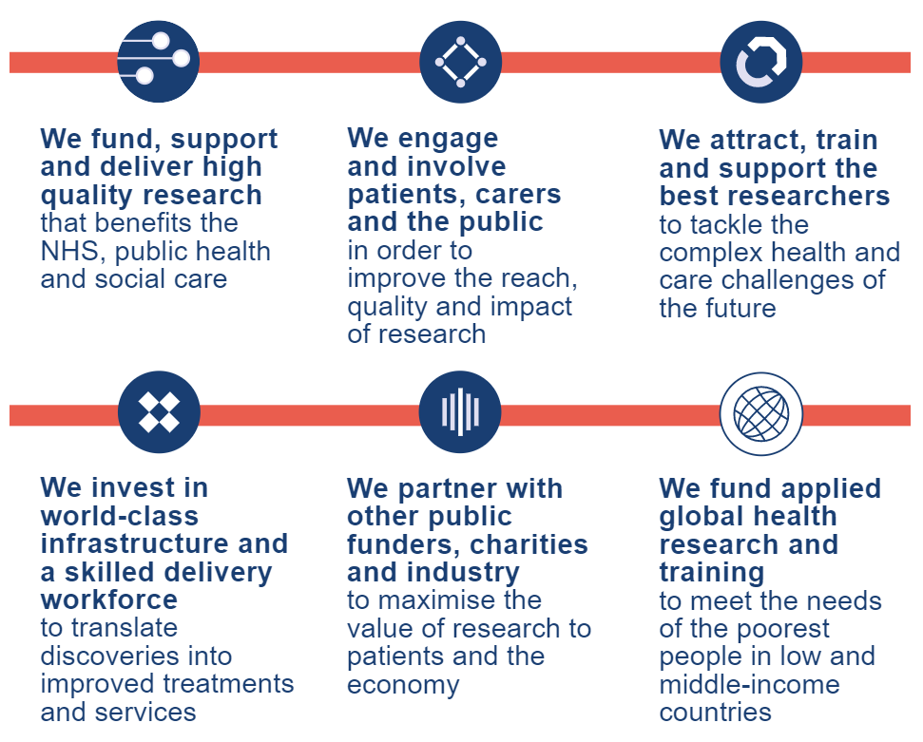
What is the NIHR’s mission?

Slide 4

What we do at the NIHR Academy
Develop and coordinate NIHR academic training,
career development and research capacity development
Manage national competitions for training and career
development awards
Attract, train and support the people conducting leading-
edge research focused on the needs of patients and the
public
Develop the skills of the next generation of health and care researchers to find lifesaving solutions to key emerging health and care problems

Slide 5
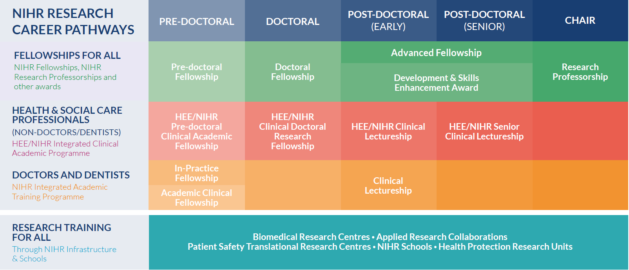
Research Training Schemes for all
HEE/NIHR Pre-doctoral Clinical and Practitioner Academic Fellowship
HEE/NIHR Doctoral Clinical and Practitioner Academic Fellowship
Research Training Schemes for practitioner academics
health & social care professionals
HEE/NIHR Advanced Clinical and Practitioner Academic Fellowship
NIHR Pre-doctoral Local Authority Fellowship
NIHR Doctoral
Local Authority Fellowship
Research Training Schemes for clinical academics
doctors and dentists
Additional Opportunities

Slide 6
NIHR Remit for Personal Awards
The overall remit of the NIHR is early translational (experimental medicine), clinical and applied health research, including social care research.
For personal doctoral-level awards the proposal:
must be for clinical and applied health research, including social care research
must have clear potential for directly benefiting patients and the public (but recognising the training element of the research)
can involve: patients; samples or data from patients; people who are not patients; populations; health technology assessment; or health services research
Early translational research is funded through NIHR infrastructure.
For Advanced Fellowships, early translational (experimental medicine) research is within remit. A clear and plausible path to patient or public benefit must, however, be demonstrable.
NIHR does not support basic research or work involving animals or their tissue.
NIHR will also support educational research and methodological research provided it has potential for practical application and the impact on patients and the public is clear.

Slide 7
Personal awards

Slide 8
Doctoral Fellowship
fellowship to undertake a PhD
majority of funding awarded in response mode with minor proportion to NIHR Academy Strategic Themes
open to clinical and social care practice applicants with the option of 20% clinical/practice time
Funding and support
3 years WTE (between 50 and 100% WTE)
funding for salary, research costs and training and development costs, including £3000 conference related costs
PhD fees
Assessment criteria
commitment and potential to develop a future health and/or care research career
high quality research and training programme suitable for a PhD
support from supervisory team and host organisation
Launches twice annually in April and October
Launches annually in January

Slide 9
Advanced Fellowship
Fellowship designed to support the following points at post-doctoral level::
- early post-doc career following award of PhD
- establishment of independence
- transition or return from a career break
open to clinical and non-clinical applicants, with the option of up to 40% clinical/practice time
majority of funding awarded in response mode with minor proportion to NIHR Academy Strategic Themes
Funding and support
2-5 years WTE (between 50 and 100% WTE)
funding for salary, research costs, a support post and training and development costs, including £2000 per year conference related costs
can apply for two sequential Fellowships up to a total of 8 years
Assessment criteria
trajectory relevant to career stage and background
high quality research and training programme
support from mentorship team and host organisation
Launches twice annually in April and October

Slide 10

NIHR- Charity Partnership Fellowships
NIHR partners with leading health and care research charities to offer jointly funded NIHR-Charity Partnership Fellowships
Support of two ‘funders’ and research communities/networks
Each application goes through the same review process. If successful, the NIHR and charity co-fund each fellowship.
For details of round specific charities see guidance notes and NIHR Website
Notes:
Relevant to Doc/Adv. Added benefits - two funders/exposure, support
Handover to Charlie after this slide
The Colt Foundation - Environmental and Occupational Health Research
Wellbeing of women - women’s health charity

Slide 11
Application and Assessment Process

Slide 12
Assessment Process
Application Window
Selection Committee Review
Shortlisting Meeting
Interviews
Awards Start
Outcomes Confirmed
Recommendations
Submitted

Slide 13
A strong application (Person, Project, Place/Training)
Is made by a candidate with the requisite experience and aspirations to lead and undertake the project, and benefit from the opportunities it will provide
Is developed from conception with the support of suitably experienced academic supervisors and advisors
Is informed by appropriate patient/public involvement and engagement
Proposes a project that:
serves as an excellent vehicle for the personal development of the candidate
has good potential to make a positive impact on care and/or health
Includes a bespoke training and development plan that is tailored to the needs of the candidate and the project
Articulates strong support for the candidate, their career development, and the project by the hosting organisation(s), which must be well placed to provide it.

Slide 14
Hints and tips for applicants

Slide 15
Pre-application advice
Know the process and the remit:
Look at the website
Read the guidance notes and NIHR Chairs reports
Contact the NIHR Academy with any queries
Talk to the NIHR Research Design Service
Don’t add PPI as an afterthought!
Know your audience:
Look up previous award holders, selection committee members, methodology experts
Talk, talk, talk before you submit:
Supervisors, current awards holders, senior academics, methodological experts, collaborators, mentors, finance office, colleagues etc.

Slide 16
Common weaknesses
“We will….” These are personal awards and the applicant should convey ownership
Clarity & Details: Research questions not clear; don’t show the relevance of the aims and objectives; not enough detail and depth
Over-ambitious: Research programme not suitable for level of award; not achievable within time frame
Applicant: Person not quite experienced enough for level they are applying (research outputs, independence, etc.); not your project
Support: Host and Supervisors not providing a strong enough statement of support or poorly articulating supervisory experience.
Training: Programme too generic and not suited/specific to the applicant’s needs and project; too centred around host organisation
Value for Money: Budget unrealistic and/or failure to justify requested resources

Slide 17
Preparing for an Interview
Do your research – NIHR always publish the composition of Selection Committees
Try and do as many mock interviews as you can
Consider the questions you might get
Think about your Plan B, what happens if your research doesn’t go to plan?
Remember to sell yourself; don’t downgrade your skills
Be enthusiastic and look like you enjoy talking about your project!
There are no trick questions; remember that the selection committee will want you to do well

Slide 18


Where to seek support and advice
For detailed advice on which opportunity best supports your background and future career aspirations contact the NIHR Academy office:
https://www.nihr.ac.uk/explore-nihr/support/academy.htm
For advice on the research you want to undertake, contact your local NIHR Research Design Service (RDS):
https:/www.nihr.ac.uk/explore-nihr/support/research-design-service.htm

Slide 19



Doctoral Fellowship Blog - Prof Gary Frost
https://www.nihr.ac.uk/blog/what-makes-an-application-excellent/10987
Advanced Fellowship Blog – Prof Jayne Parry
https://www.nihr.ac.uk/blog/the-common-characteristics-of-a-great-fellowship-application/20175

Slide 20
Additional Resources
learn more about the programmes and opportunities available on the NIHR website https://www.nihr.ac.uk/academy
NIHR funding opportunities https://www.nihr.ac.uk/researchers/funding-opportunities/
NIHR events https://www.nihr.ac.uk/about-us/events.htm
NIHR webinars https://www.youtube.com/playlist?list=PLIa1oelW_zJ_yJGZl7djq7-OOTWPGY_O4

Slide 21


Keep up to date
Call us on 0113 532 8444
E-mail us at academy-awards@nihr.ac.uk
Follow us on Twitter: @NIHRCommunity
Follow us on LinkedIn: linkedin.com/showcase/nihr-community
Receive NIHR newsletters, including funding alerts, by signing up at
www.nihr.ac.uk/about-us/stay-up-to-date.htm

Slide 22
NIHR Funding Opportunities
Notes:
We support applications to NIHR and other national peer reviewed funding sources for example MRC and major charities. There is a list on our website to check.
As NIHR is the main funder and contains many different funding stream we will go through this in a bit more detail.

Slide 23
NIHR Remit
“Commissions and funds health, public health and social care research that is essential for improving the health and wealth of the nation”
People and patient based applied health research
Clearly demonstrate the potential to have an impact on the needs of patients and the public within 5 years of its completion
No basic research or work involving animals and/or animal tissue
NIHR is also prepared to support research into medical education

Slide 24
1. Funding Awards and Grants
EME
RfPB
ES
PRP
HS&DR
NIHR Funding Streams
PHR
HTA
PGfAR
i4i
PDG
Notes:
Ten funding streams

Slide 25
1. Funding Awards and Grants
Efficacy and Mechanism Evaluation (EME): ambitious studies evaluating interventions with potential to make a step-change in the promotion of health, treatment of disease and improvement of rehabilitation or long-term care
Evidence Synthesis (ES): identifies, evaluates, combines and summarises information from a range of sources to provide decision makers with the best possible information about the effects of tests, treatments and other interventions used in health and social care.
Health Services and Delivery Research (HS&DR): rigorous and relevant evidence to improve the quality, accessibility and organisation of health and social care services.
Health Technology Assessment (HTA): research about the clinical and cost-effectiveness, and broader impact of healthcare treatments and tests, for those who plan, provide or receive care from NHS, and social care services.
Invention for Innovation (i4i): Preclinical and clinical development of innovative medical technologies (essentially getting medical technology into the NHS)
Notes:
Also Research for Social Care (RfSC) calls annually (September)

Slide 26
2. Funding Awards and Grants
Programme Development Grants (PDG): targeted preparatory work to develop a competitive Programme Grants for Applied Research (PGfAR) funding application. They can also be used to further develop an existing or ongoing PGfAR-funded programme of research
Programme Grants for Applied Research (PGfAR): Programmes of research that aims to provide evidence to improve health outcomes through health promotion, prevention and optimal disease management. Programme Development Grants (PDG) are given to help prepare for PGfARs
Public Health Research (PHR): research to generate evidence to inform the delivery of non-NHS interventions, intended to improve the health of the public, and reduce inequalities in health.
Policy Research Programme (PRP): High quality and cost-effective research to deliver relevant, timely and accessible evidence to inform national policy decisions across the health, care and public health systems.
Research for Patient Benefit (RfPB): Research related to day-to-day practice of health service staff and with an impact on the health and well-being of patients and users of NHS – clear trajectory to patient benefit
Notes:
Also Research for Social Care (RfSC) calls annually (September)

Slide 27
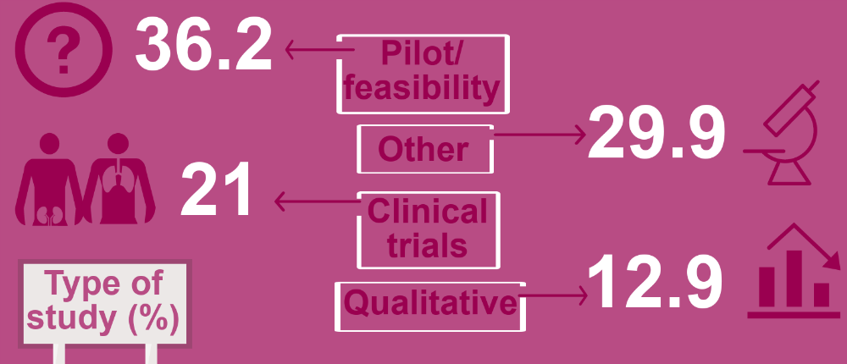
Research for Patient Benefit (RfPB)
Tier system: tiers assessed together and value for money
Clear articulation of trajectory to patient benefit
Keen to fund ECRs (with right mentorship)
Will fund:
Innovation/med tech e.g for feasibility, acceptability
Social care research

Slide 28
3. Global Health Research Portfolio
Research and Innovation for Global Health Transformation
Policy and Systems Research
Research Professorships
Research Training Programme
Research Centres
Research Units
Research Groups
Notes:
The NIHR Global Health Research Portfolio uses UK aid to fund high quality applied health research and training in areas of unmet need. The research is for the direct and primary benefit of people in low and middle income countries (LMICs).
Main one: RIGHT High-quality applied health research for the direct and primary benefit of people in low and middle-income countries (LMICs), using Official Development Assistance (ODA) funding.

Slide 29
Proposals for Funding: What are funders looking for?
Notes:
We support applications to NIHR and other national peer reviewed funding sources for example MRC and major charities. There is a list on our website to check.
As NIHR is the main funder and contains many different funding stream we will go through this in a bit more detail.

Slide 30
What are funders looking for?
Is there a need for the evidence?
The importance or burden of the problem to those who would use the evidence?
What the study would add to the existing body of knowledge?
Is it likely to lead to improved health or social care and practice change?
Is it likely to have a high impact on patients, the public, people working in healthcare?
Notes:
… and whether the research is needed

Slide 31
What are funders looking for?
Is the research value for money?
Are the costs reasonable and commensurate with the proposed work?
Are the costs to health and care service reasonable in relation to the likely benefits of the research to decision-makers, patients, public?
Notes:
Individual funding streams have specific remits and criteria
General core criteria:

Slide 32
What are funders looking for?
Is the research rigorous?
Can the study design answer the research question?
Is the study feasible and deliverable?
Does the team have the appropriate skills mix and experience?
Is project management of the study sound?
Notes:
Individual funding streams have specific remits and criteria
General core criteria:

Slide 33
Patient and Public Involvement and Engagement
Identifying and prioritising topics
Evaluation
Commissioning e.g. Public involvement
in funding committees
The Research Cycle
Study Design
Dissemination
Managing Research
Analysis & interpretation
Undertaking Research
e.g. data collection

Slide 34
Equality, Diversity & Inclusion (EDI)
The NIHR aims to be a diverse and inclusive funder
They want to:
Understand the causes of inequities and barriers to diversity
Extend reach to include communities where research will make the biggest difference
Embed equality, diversity and inclusion in NIHR culture and ways of working
The INCLUDE Project key characteristics of an underserved group:
Lower inclusion in research
High healthcare burden
Differences in how a group responds to or engages with healthcare interventions

Slide 35
Research Design Service (RDS)

Slide 36
Role of the RDS
Funded by National Institute of Health and Care Research (NIHR)
“To offer fit for purpose advice and support on research design and methodology to researchers making funding applications”
“To increase the number and proportion of high-quality applications for funding”
“To provide consistent national coverage, with a focus on NIHR Programmes”
Notes:
We are funded to have a key role helping to refine research questions to ensure that they meet NIHR priority areas, and that research proposals have the right team and skill mix to deliver the proposed research.

Slide 37
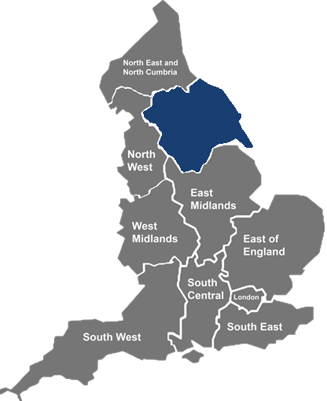
NIHR Research Design Service (RDS) YH
The RDS was established in 2008 by NIHR in order to improve the number of high-quality applications received by the NIHR
It is a free service providing confidential advice to those applying to peer-reviewed health and social care funders
The RDS is split into ten regions
RDS Yorkshire and Humber is a collaboration between the universities of Leeds, Sheffield and York
Yorkshire and the Humber
Notes:
The NIHR Research Design Service Yorkshire and Humber is one of 10 regional services across England that was set up in 2008 to offer design and methodological support to health and social care researchers who are developing research and fellowship applications.
We are a partnership between the Universities of Sheffield, Leeds and York and have advisers based at each of the three Universities who are research-active and have considerable expertise in developing and designing high quality research proposals.
The RDS supports health and social care researchers across England on all aspects of developing and writing a grant application including research design, research methods, identifying funding sources and involving patients and the public.
And our specialist advisers are able to provide expertise in statistics, qualitative research, epidemiology, health economics, systematic reviewing and information resources and public involvement in research.
And best of all, the advice we provide is free and confidential.

Slide 38

Design Inclusive Research
The RDS can help
Scope
Funding
Stream
Importance or burden of problem
Extend existing body of evidence
Appropriate research design and analysis plan
Steps to reduce bias
Literature
Design
Benefit to individuals, organisations and nations
Pathway to change
Accessible publication
Unbiased report
Inclusive
Research
Proposal
Diverse public contributors
Meaningful and appropriate
Individuals’ needs supported
Appropriate reimbursement
Impact and
Dissemination
Public
Involvement
Diverse research team
Multidisciplinary
Culturally competent
Team
Feasibility
Eligibility criteria - inclusive of under-served communities
Accessibility of research
Local barriers to recruitment
Participant/carer costs considered
Ethical
Considerations
Consent procedure
Participant burden
@NIHR_RDSYH
Notes:
The advice you receive from the RDS will focus on your research proposal. The RDS is your critical friend who will help you identify and consider potential issues at an early stage.
Firstly, you’ll need to tell us what the problem is and how your research idea will address this.
Design / Methodology - Refine the research question and discuss the best method to produce useful, timely and relevant research findings that actually answer your research question.
Identify appropriate funding sources, look at deadlines and whether your research idea is within scope.
Patient and Public Involvement and Engagement –, but you need to look at how meaningful PPIE can be embedded throughout the project / public co-apps / steering committee / plain English summaries
Impact - What is the pathway to impact? What will change in the long term, for whom, to what extent and when? How will new understanding benefit individuals, populations, organisations, communities or the nation. How will the main outputs or knowledge be shared and used in a timely manner?
Team composition – appropriate lead for application, identify collaborators and their key role in the research / build an appropriate team including methods experts / signpost researchers to specialised support e.g. health economists and statisticians.
Literature - Existing evidence and identify any gaps. We have specialist advisers who can advise on literature searches.
Ethical considerations - Look at regulatory and ethical considerations. Does it require NHS ethics and MHRA review? Patient level consent, patient burden, minimising risk.
Feasibility – Are there any non-NHS intervention costs?
The added value of the RDS is that we can provide:
Up to date insights from funding panels and members that sit on panels.
RDS staff are connected to Senior Investigators, panel chairs and funding programme managers.
Understand the application process and who you need to talk to.
We can provide an assessment of readiness to submit.
Application review with structured feedback provided.
The RDS hosts workshops on:
“Grantsmanship” to help you get the narrative right
“Fellowships”

Slide 39
Discussion with RDS
Who will benefit from this research and how will it be implemented?
What’s the best research design for answering this question?
Have you got the science right?
Do you have skills in using this method?
Do you need help in any area?
Who have you talked to about this research idea?
Patients/ Public / Stakeholders
Gaps in evidence confirmed by review of literature?
Is some kind of systematic/ scoping or other review required?
What does your team look like and does it have the right mix of clinical and methods expertise?
Do you have a defined research question?
Using PICO or other framework?
Have you established a case of need ?
Prevalence of problem
Priority of problem?
Is your proposal good value for money?

Slide 40
What the RDS does not do
Write the application / protocol
Help develop a project where there is no intention of submitting it to a recognised funding stream
Support applications that are not research (e.g. audit)
Provide supervision or informal support for students
Continue to support applications where the work has remained unchanged from previous submitted versions

Slide 41
Working with the RDS
Get your name on our mailing list
Book an ‘early’ appointment with the RDS
Submit a summary of your research idea through our website online form www.rds-yh.nihr.ac.uk
Face-to-face or online advice session/s
Review of application
Workshops
Grant Writing
Fellowships
Notes:
Mailing list where we send useful information and could can have a look at our website as there is lots of information on there about how we can help and pointers for research.

Slide 42



Sheffield Tel: 0114 222 0828
Leeds Tel: 0113 343 6966 York Tel: 01904 321 726 email: rds.yh@nihr.ac.uk www.rds.nihr.ac.uk

