Slide 1
Key challenges facing the NHS
Professor Chris Ham
Chief Executive
21 September 2015

Slide 2
2010-15
NHS spending grew in cash and real terms, but much more slowly than historical trends
Adult social care spending was cut with c.25% fewer people receiving publicly funded care
NHS largely coped until 2014 when deficits emerged; in 2014/15 aggregate provider deficits were c.£800 million
Forecast NHS provider deficits in 2015/16 are up to £2bn

Slide 4
2015-20
NHS budget will increase by ‘at least’ £8bn by 2020/21
ADASS estimates adult social care faces a funding gap of £4bn by 2020/21
NHS needs to deliver £22bn productivity improvements to bridge its funding gap of £30bn
This has never been achieved before

Slide 6
Three big challenges
Sustaining existing services and standards of care
Developing new and better models of care
Supporting and reforming primary care

Slide 7
Sustaining existing services
Keeping the focus on quality of care and patient safety
Maintaining good performance on key targets like waiting times
Recruiting and retaining (and training) the workforce of the future
Balancing budgets

Slide 9
Developing new models of care
Implementing the five year forward view and integrating care
Giving priority to prevention and population health improvement
Taking forward Devo Manc and extending to other city regions over time
Embracing new technologies where they bring benefits

Slide 10
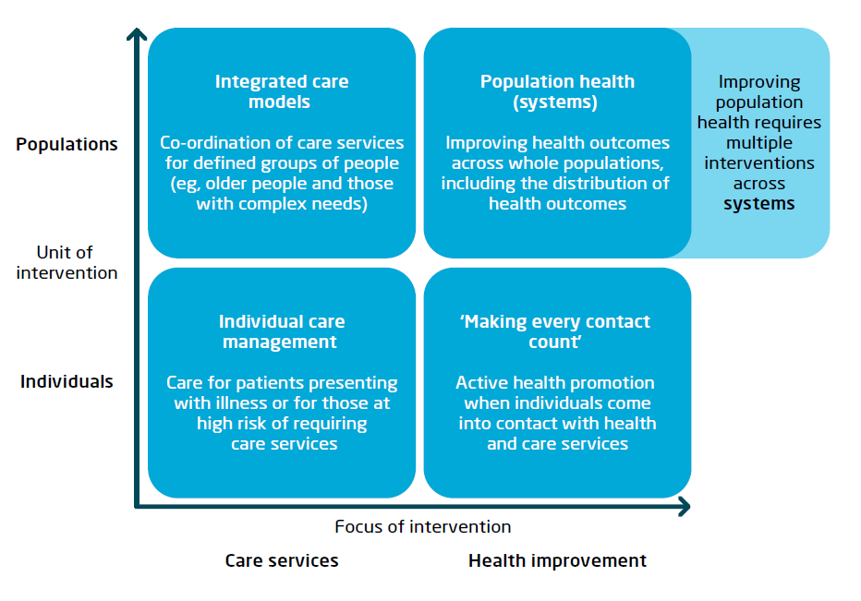
The focus of population health systems

Slide 11
Supporting and reforming primary care
A key role at the heart of new care models
A future where practices work in collaboration e.g. through federations
Federations become building block for providing integrated out of hospital services
Technology supports care to be delivered in different ways
Federations engage with specialists to provide more care out of hospital

Slide 12
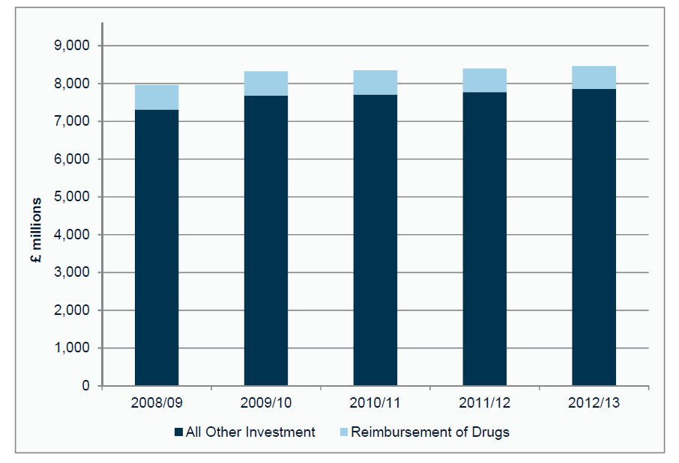
Investment in general practice in England, 2008/09—2012/13
HSCIC (2013). Investment in general practice 2008/09 to 2012/13

Slide 13
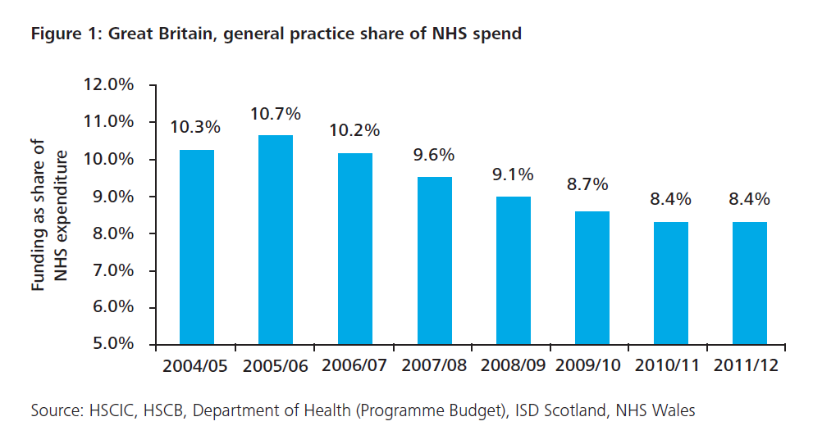
GP funding as a share of NHS expenditure
Deloitte (2014). Under pressure: the funding of patient care in general practice

Slide 14
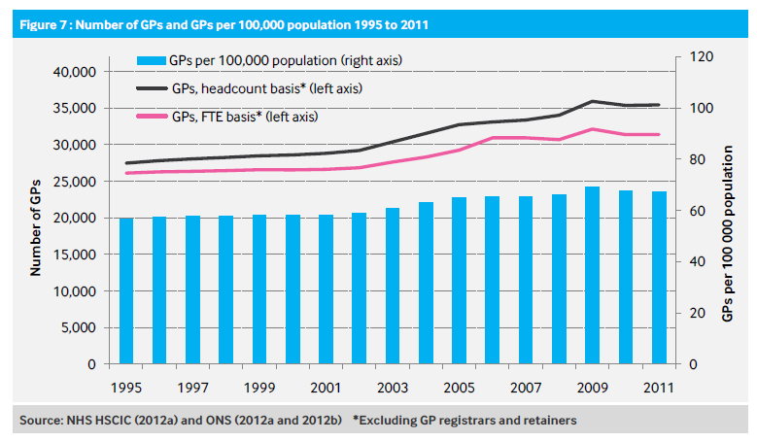
Number of GPs in England, 1995—2011
Centre for Workforce Intelligence (2013). GP in-depth review: Preliminary findings
Notes:
Medical workforce on the whole has grown, and has shifted in balance towards secondary care (see following slide).
Between 1995 and 2011, number of (actual) GPs grew by around 30% -- on a FTE basis, this was an increase in the number of GPs by 20%.
This rate of growth is far slower than in some other parts of the NHS. For example, the number of consultants in other specialties doubled over the same period.

Slide 15
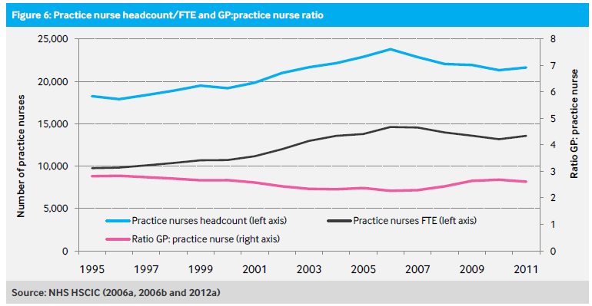
Number of practice nurses and GP:practice nurse ratio
Centre for Workforce Intelligence (2013). GP in-depth review: Preliminary findings
Notes:
In recent years, the number of practice nurses employed has fallen.
This may be due to a number of factors – including practices replacing nurses with HCAs, or GPs taking on increased workloads.

Slide 16
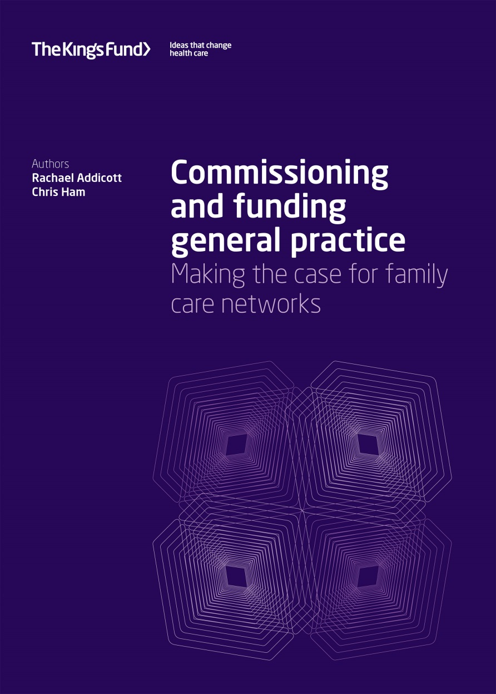

Slide 17
The government’s mistake
GPs are first and foremost providers rather than commissioners
Too much attention has been given to CCGs and too little to new models of provision
Enabling GPs to strengthen their role as providers is what many GPs want
Just doing more of the same is not the answer

Slide 18
New models require different ways of organising care: Family care networks
Primary care should be at the core of community services
Practices must be aligned with and work hand in hand with other community services
Integrated health and social care teams able to provide a rapid response are needed
Intermediate care and OOH care should be part of these new models
Some specialist services should work alongside practices and community services

Slide 19
New models require different ways of funding care
A population based, capitated contract should be used, linked to defined outcomes
CCGs need to work with NHS England and local authorities to commission
The contract should be held by networks who choose to develop new models of care
Networks need a range of capabilities to manage the contract successfully
Savings could be re-invested e.g. to increase spending on primary care

Slide 20
A new deal for general practice?
Investment linked to reform
Practices and networks (or super partnerships)
Networks leading development of integrated services in the community
More flexible use of budgets to increase spending on primary care

Slide 22
In summary
The government needs to provide adequate funding for health and social care in the SR
New models of care need to be developed to meet changing population needs
Primary care needs the resources and workforce to meet growing demands
Primary care needs to change to survive and thrive

Slide 23
What about the survival of the NHS?
The SR will shape the fate of the NHS and social care during this parliament
If the government does not provide adequate funding, it should be honest about the consequences
The politics within the government will be critical
On which side of the argument will the PM come down?

Slide 24
