Slide 1
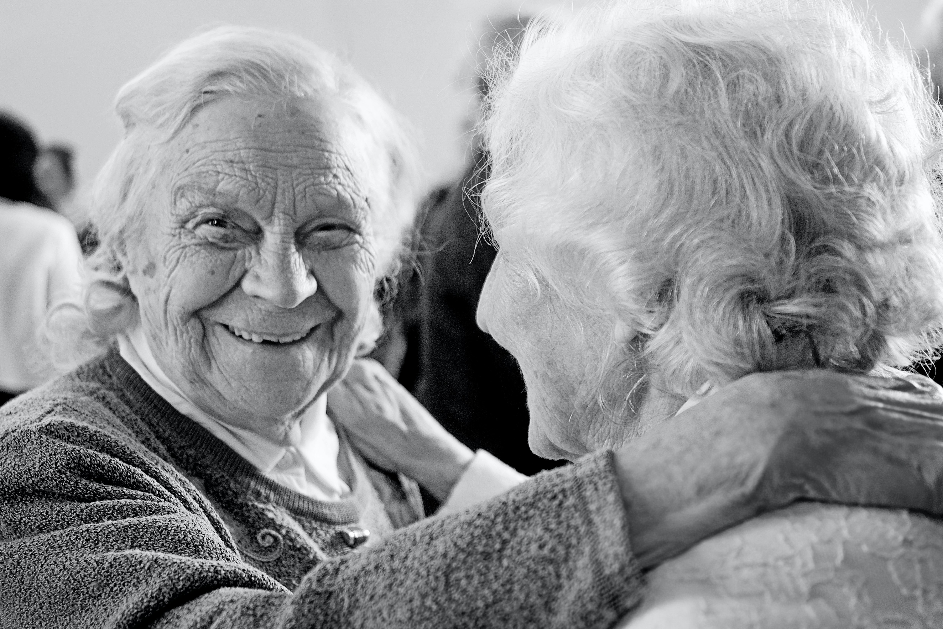




Involving public and stakeholders to conduct meaningful dementia research
Dr Clarissa Giebel
Senior Research Fellow
University of Liverpool/ NIHR ARC NWC
@ClarissaGiebel
NIHR 3 Schools Seminar, 12th Dec 22

Slide 2
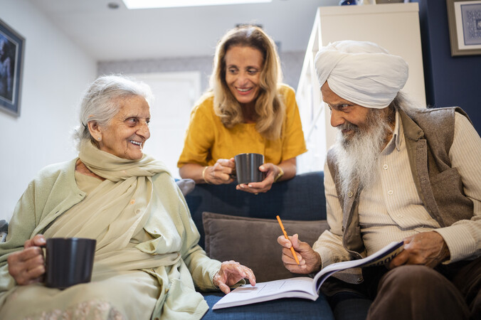
Unmet mental health needs of unpaid and paid carers for older adults with and without dementia
April 22-Sept 23
Interviews
Focus groups
Co-production workshops
Training courses

Slide 3
Set up in 2019
Academics, Health & Social Care professionals, Charities, Commissioners, People with lived and caring experiences of dementia and ageing
Public webinars
Monthly Journal Clubs
Regional networking meetings
Annual Conference

Slide 4
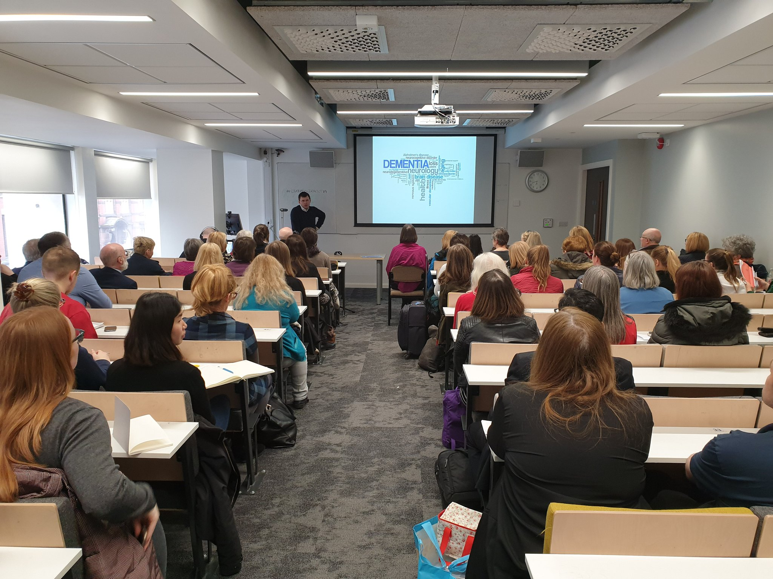

Slide 5
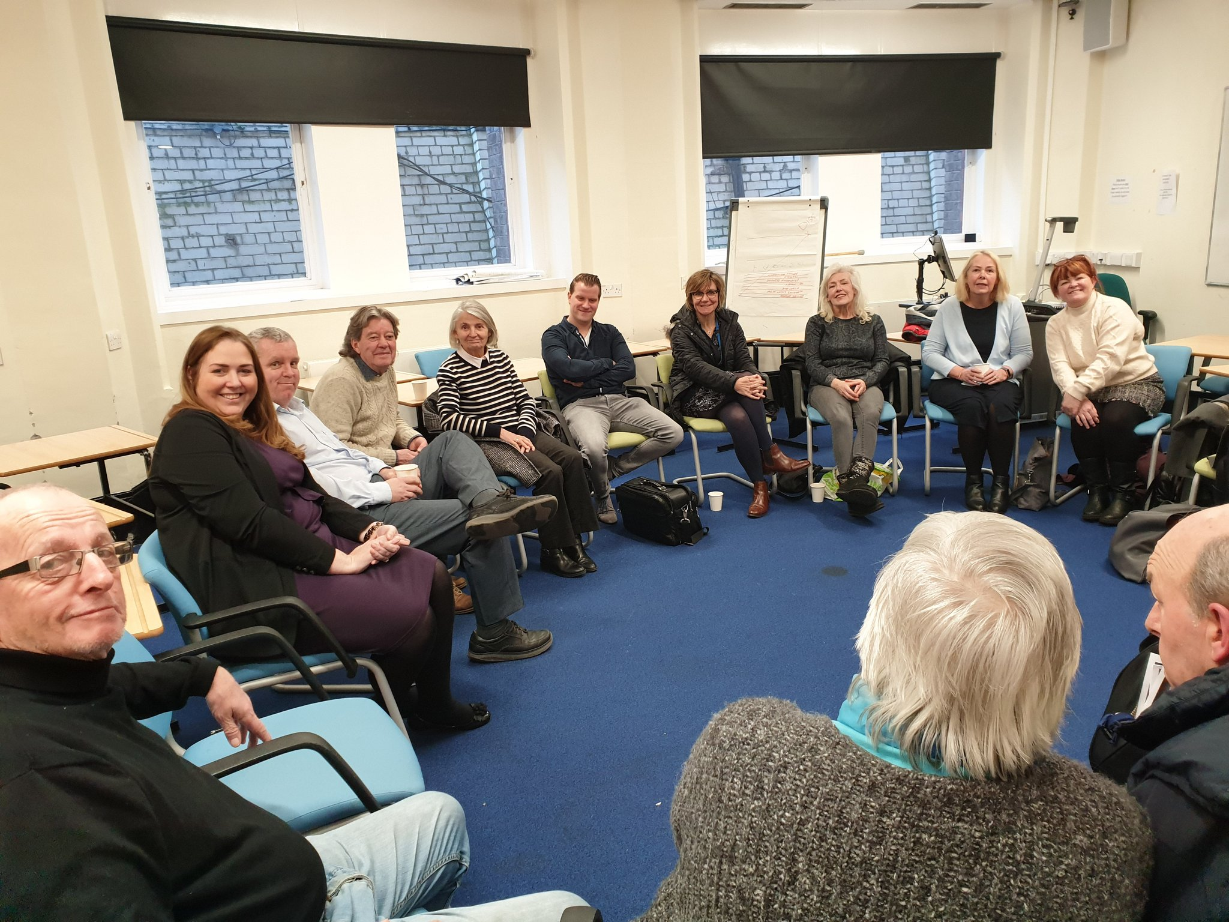
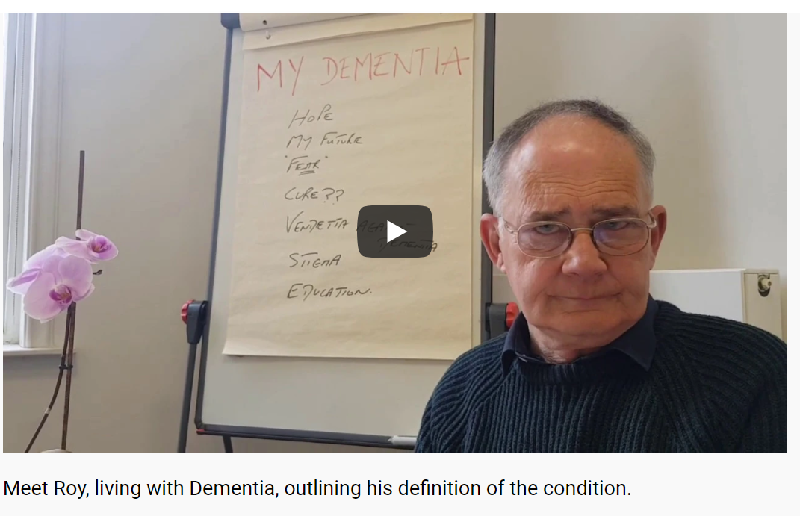
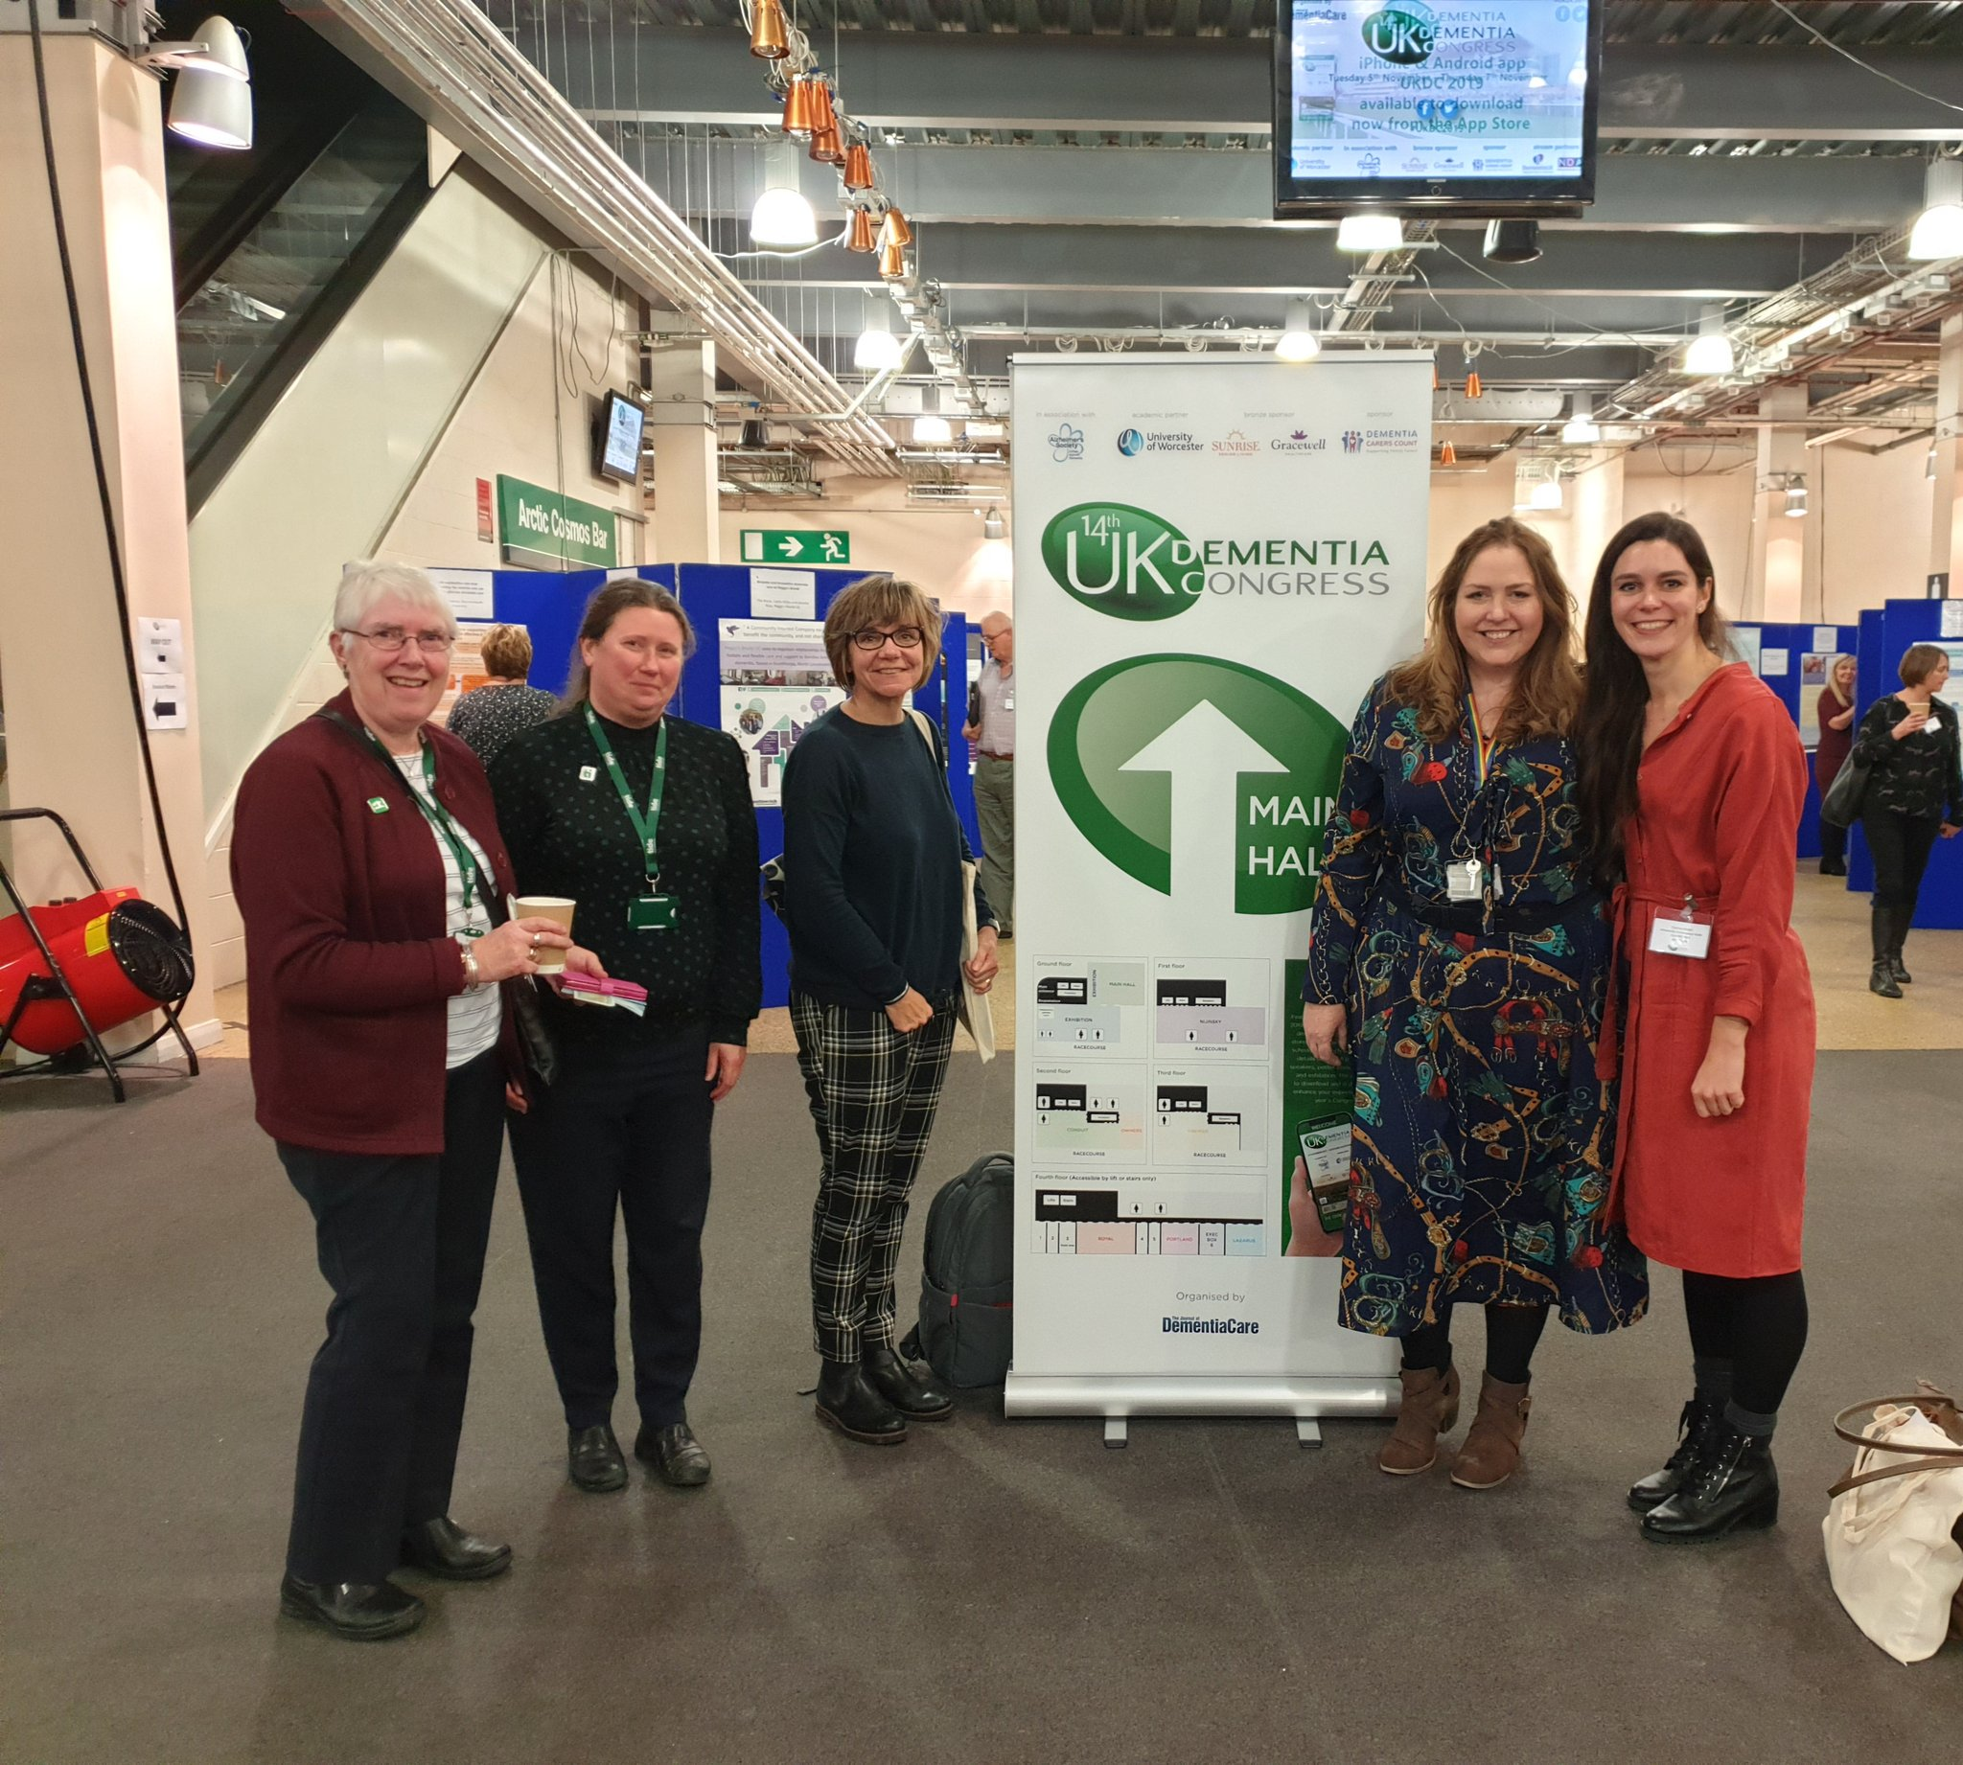
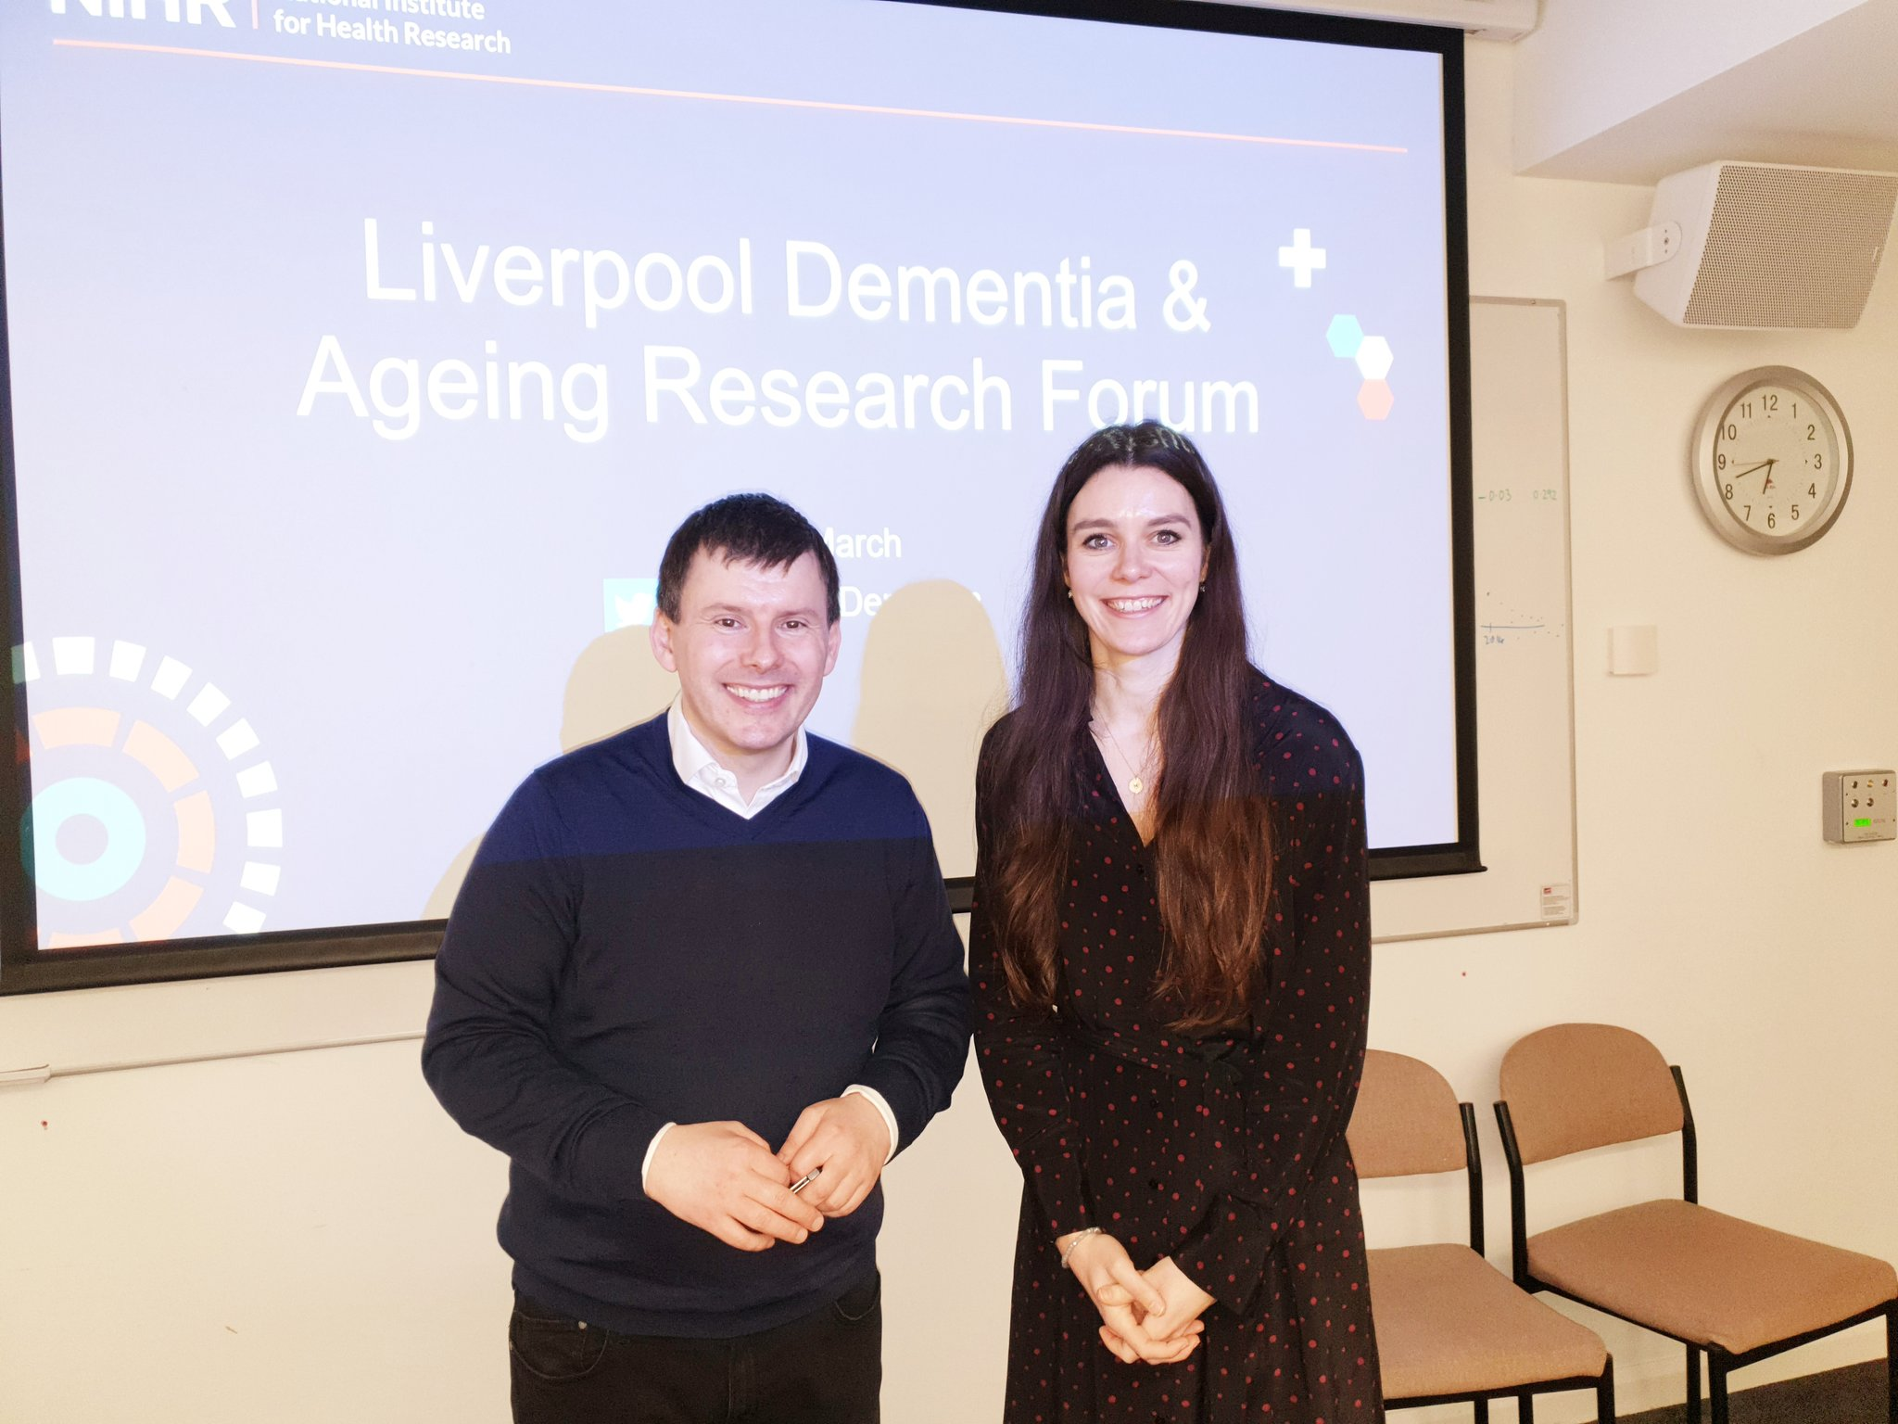

Slide 6
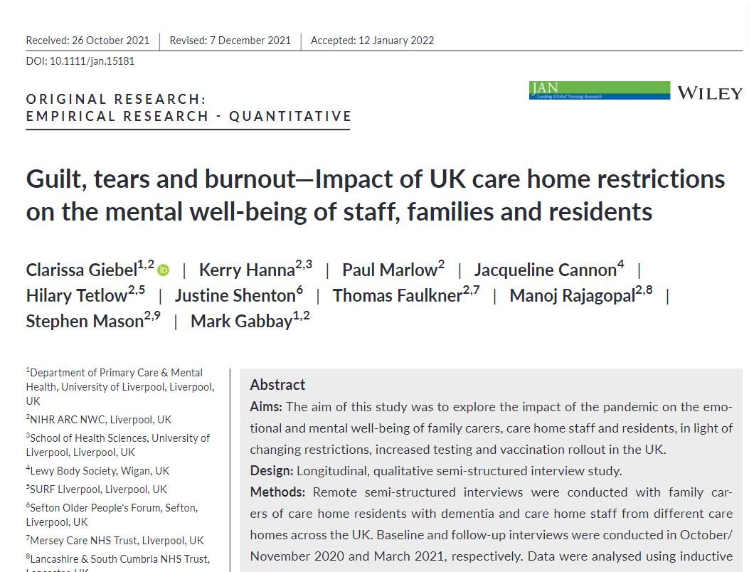
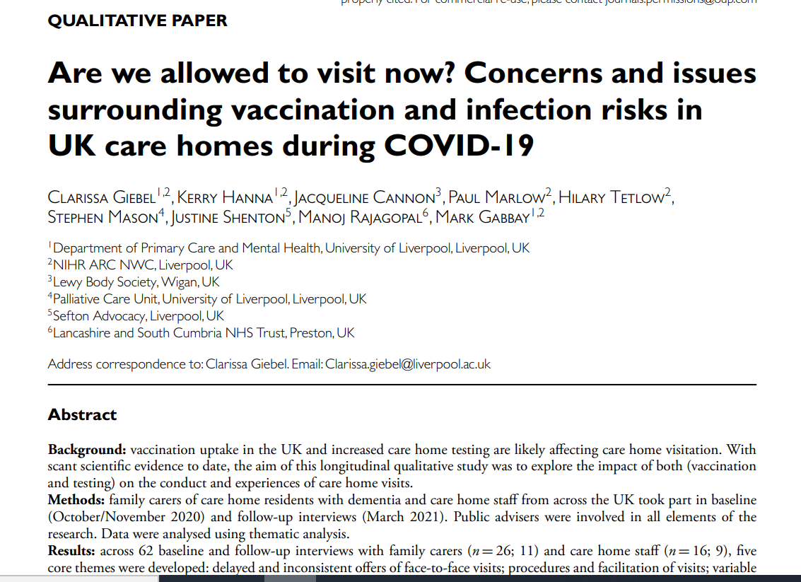
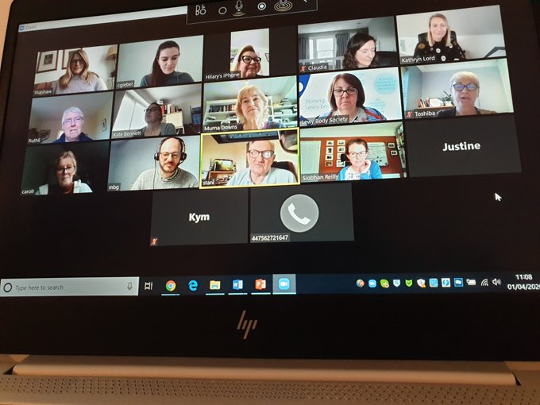
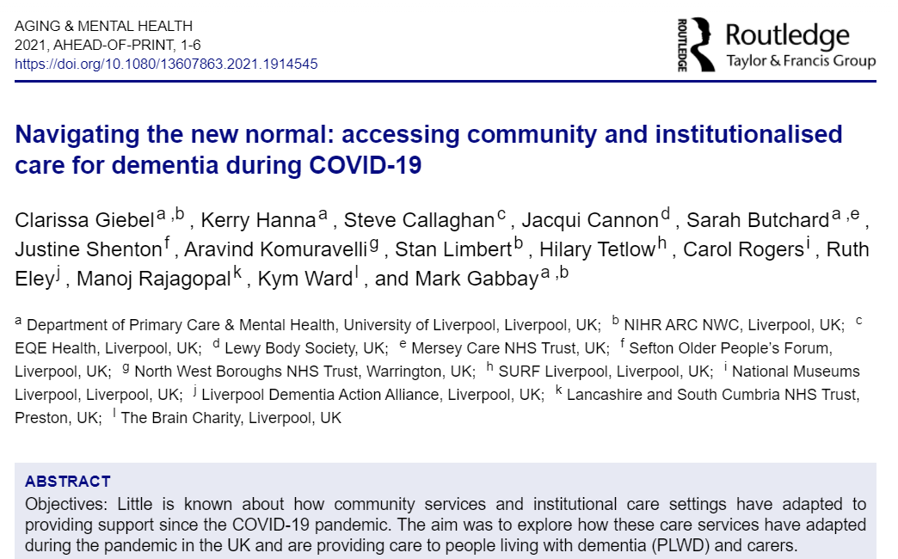
Some of our research

Slide 7
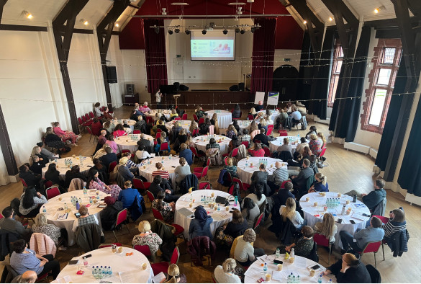
4th annual Conference

Slide 8

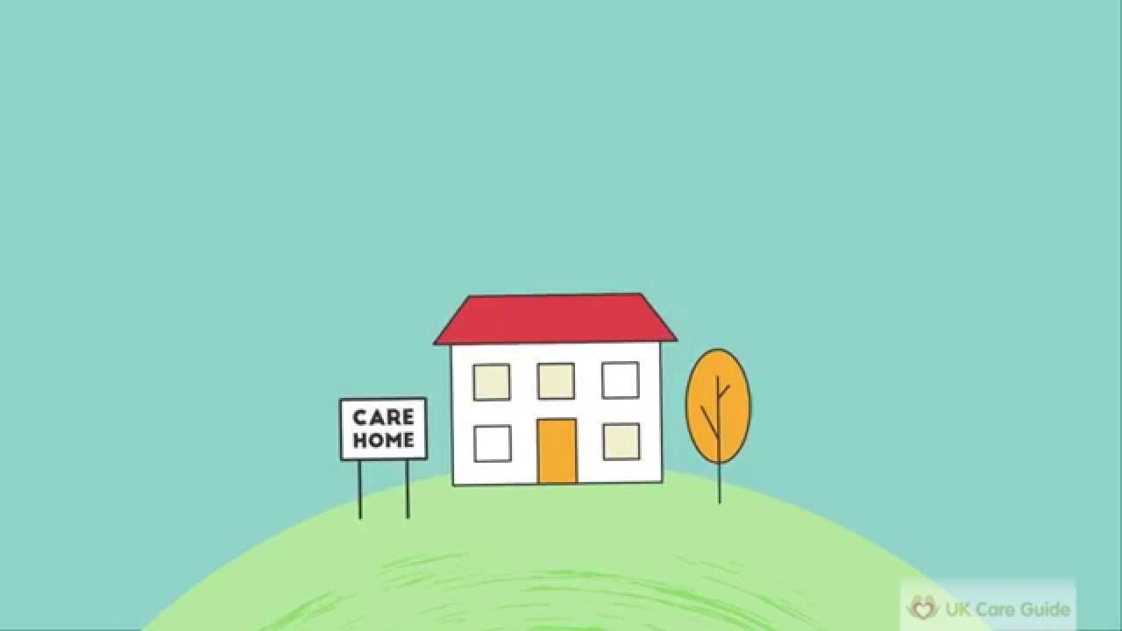

Community
Care homes
50 qualitative baseline interviews
(42 carers & 8 people with dementia)
20 follow-up interviews
(16 carers & 4 people with dementia)
42 qualitative baseline interviews
(26 family carers & 16 care home staff)
20 follow-up interviews
(11 family carers & 9 care home staff)
April 2020
Oct – Nov 2020
June/July 2020
March 2021

Slide 9
Faster deterioration
“I think that the longer this goes on the more he won’t be able to go back to the things that he was doing. He would go into the village himself and go to get a few bits of shopping sometimes or he would walk up to church.”
Female carer (Daughter)
“Five weeks ago my Dad was a totally different person than he is now and he won't come back from this.”
Female carer (Daughter)
Giebel, Cannon, Hanna et al. (2021). Impact of COVID-19 related social support service closures on people with dementia and unpaid carers: a qualitative study. Aging & Mental Health, 25(7):1281-1288.

Slide 10
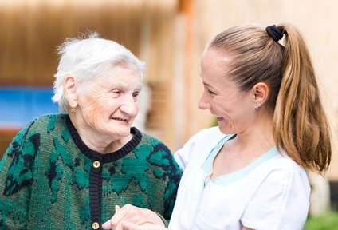
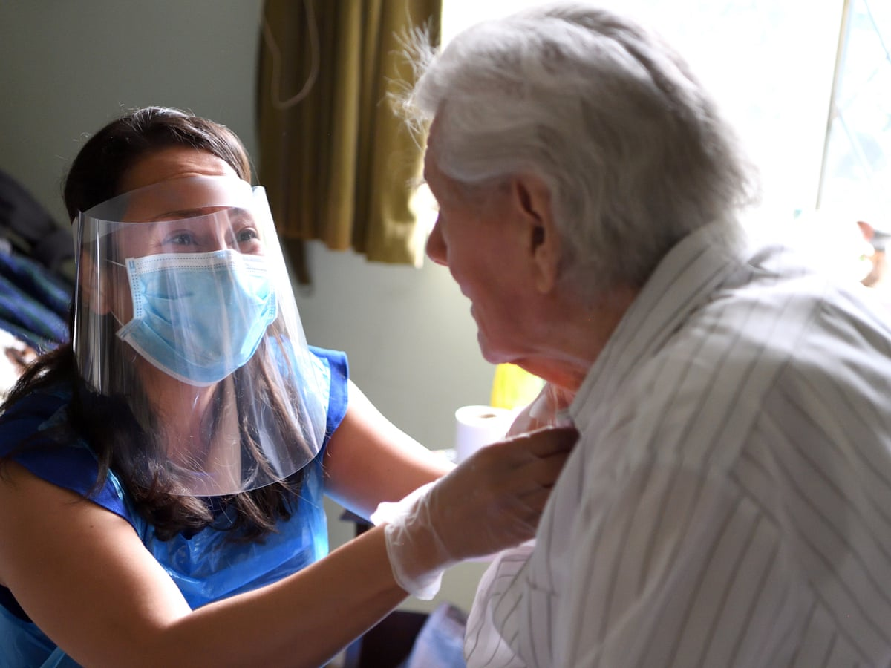
Decision making for receiving paid home care
BMC Geriatrics (2020) doi: 10.1186/s12877-020-01719-0

Slide 11

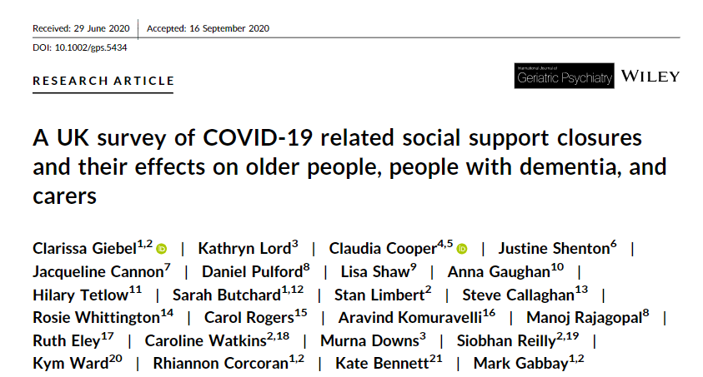
Anxiety
Mental well-being
People with dementia, older adults
Unpaid carers, older adults

Slide 12
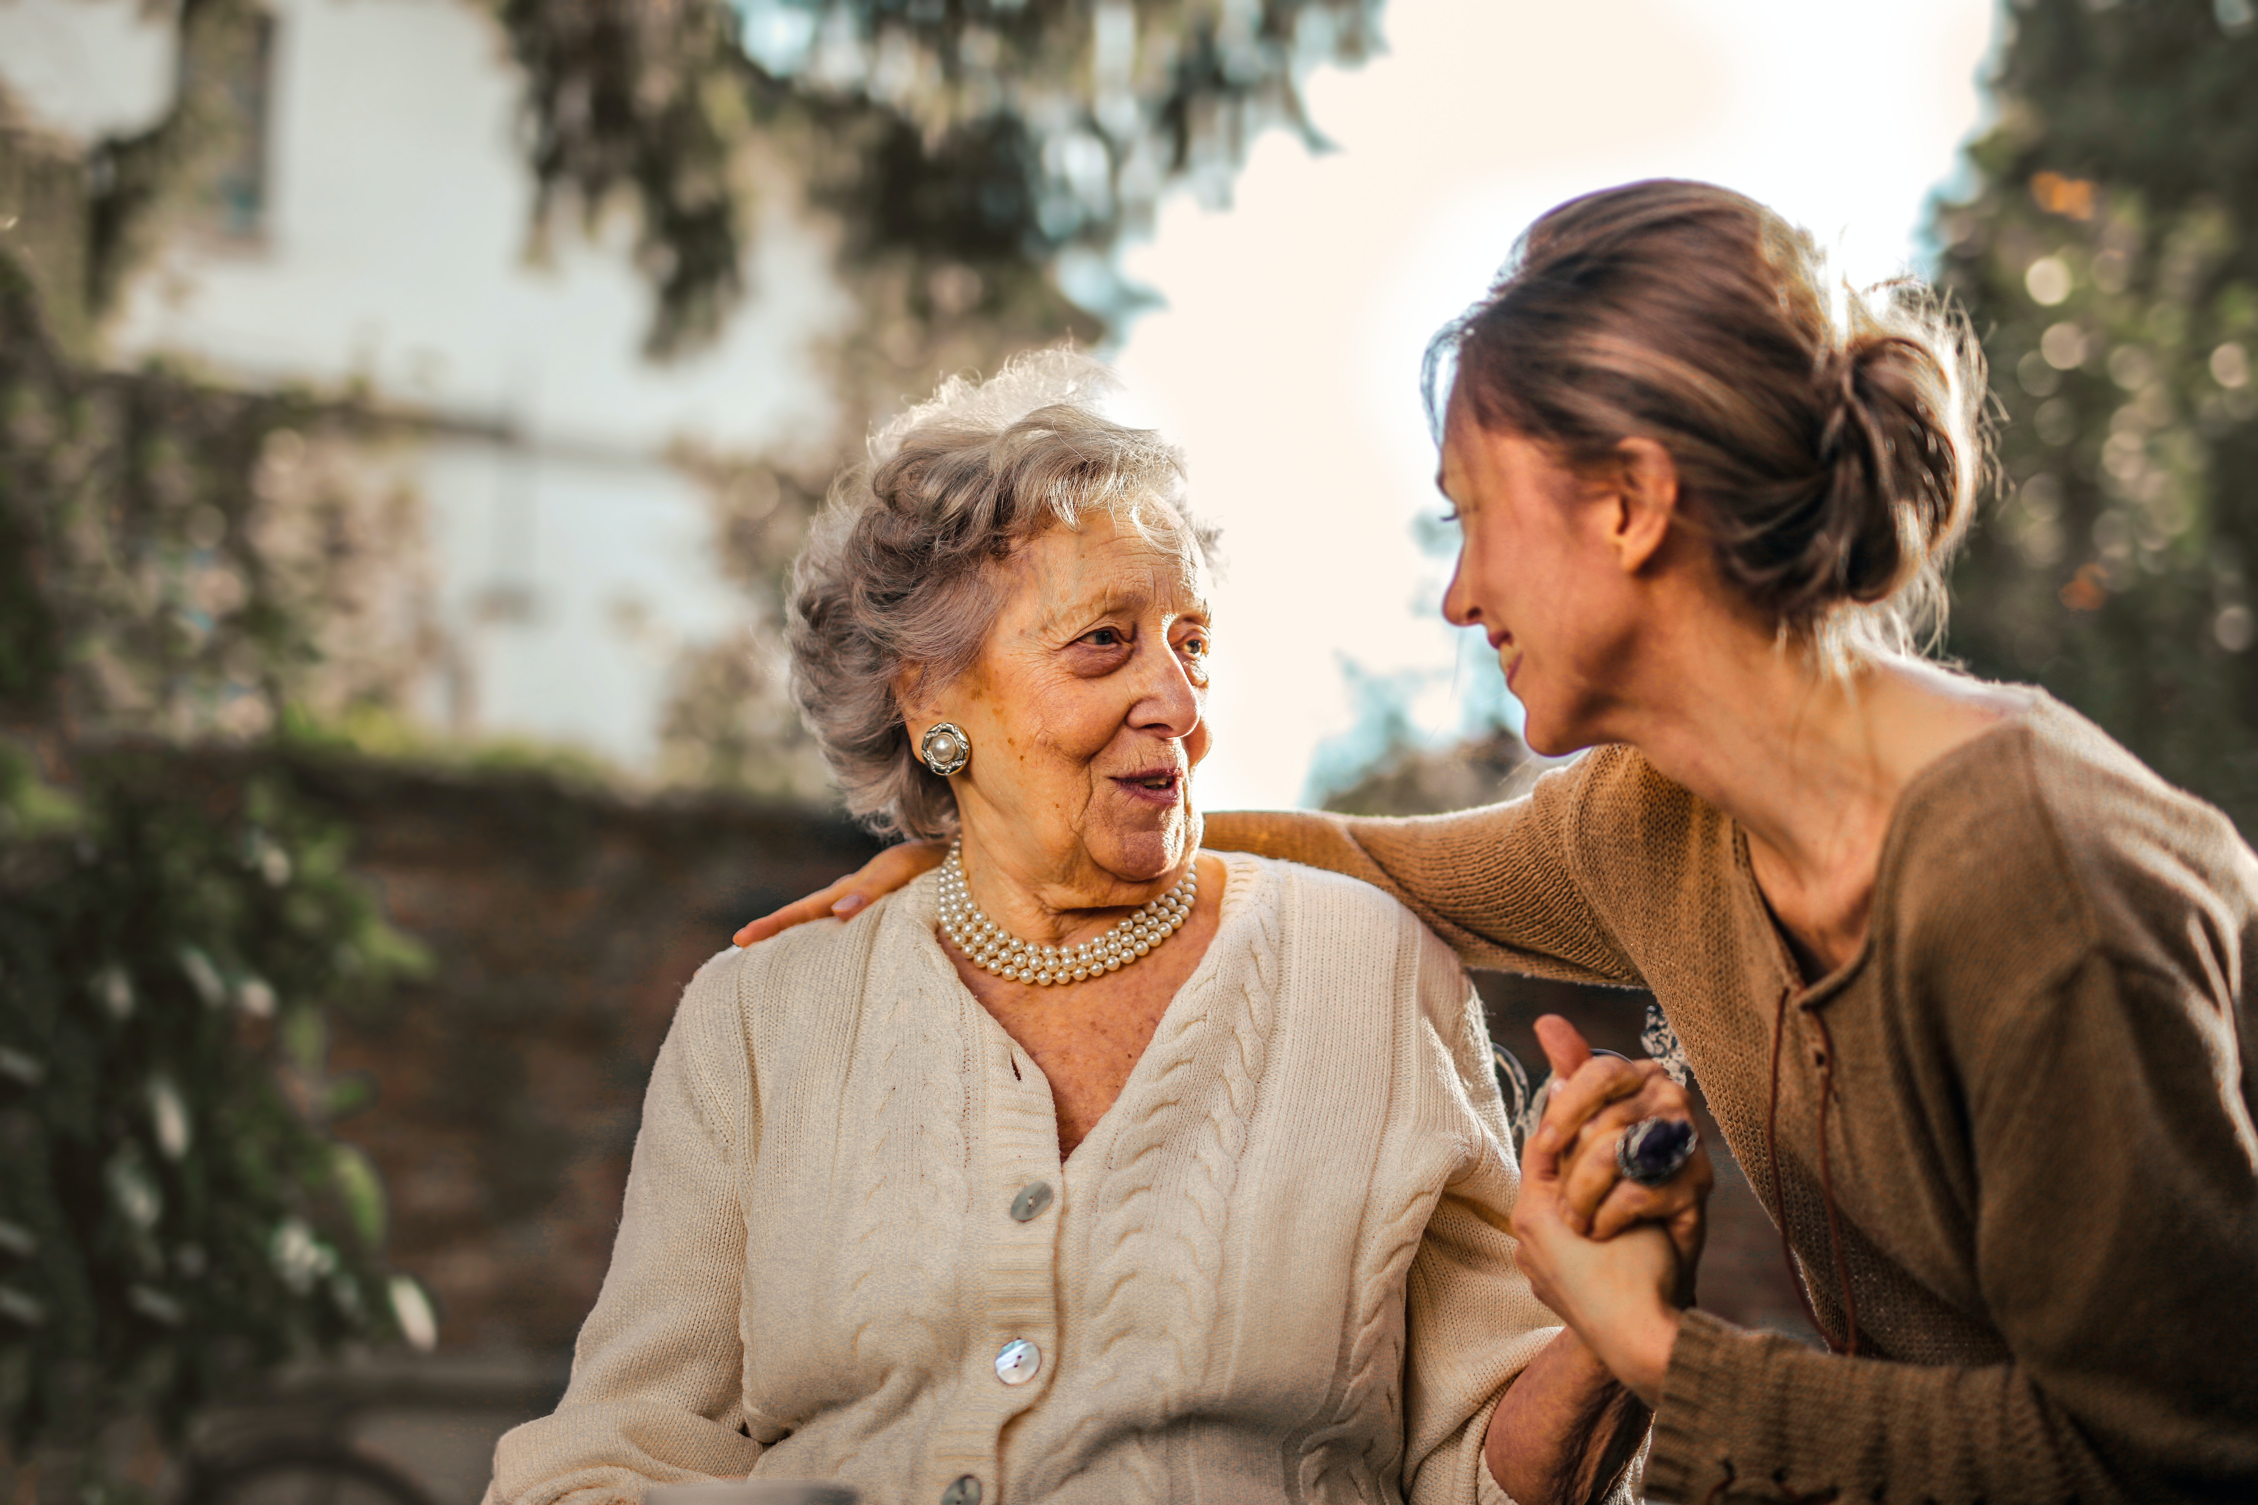
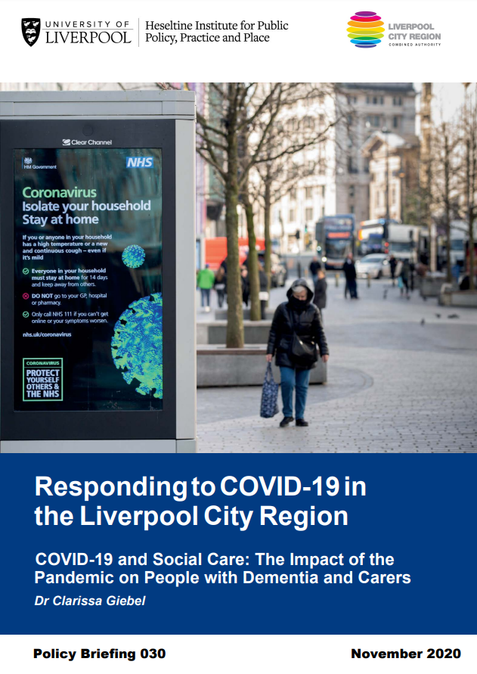
No support for carers in terms of care provision
Generally poor mental well-being
Reductions in mental well-being linked to reductions in social care access

Slide 13
From community to care home during COVID-19
“she [PLWD] got that bad I had to put her in a home because I couldn’t cope with her and my mum and dad because she just wanted to stay at home and didn’t want to come to the groups and mix. So I can see the impact of going out to groups and staying in because she went downhill” Female carer (daughter)

Slide 14
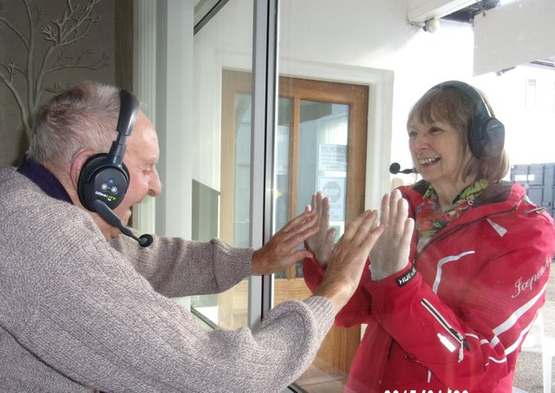
Pod visits
Garden visits
Window visits
EoLC visits
Remote visits
Giebel, Hanna, Cannon et al., 2022. Age & Ageing

Slide 15
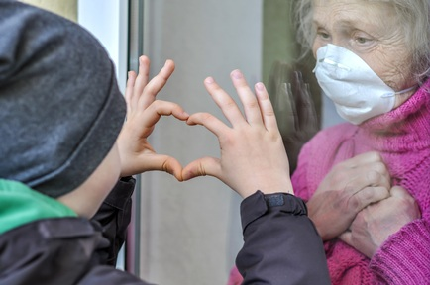
Changes to visitation rights
“so initially we had essential visitors for somebody who was end of life care and then we kind of allowed people to come in as essential visitors for people who were just unwell generally sort of for their mental health.” ID06, female CH staff

Slide 16

Lack of communication
“the acting services team manager says that video consultations at this present stage is the right strategy. But surely when I was driving through with my brother there were other family members who were visiting their relatives. So, some members in the care home were given access to their relatives, whereas our family we were not given access so I don’t know why that would be.” ID19, male family carer, son

Slide 17
Guilt
“know the whole thing is bizarre but it’s also exceptionally distressing and although this sounds a bit dramatic I have this overwhelming feeling that I've abandoned him.”
“we've abandoned her and I was sort of feeling obligated really in a lot of ways to go every week at least just so my mum knew we were there, but I could no longer do that and it was quite stressful for me to feel sort of like I should be going to see her and I couldn’t.”
Giebel, Hanna, Marlow et al. 2022 Journal of Advanced Nursing, doi:10.1111/jan.15181

Slide 18


Relationship breakdowns
“it just got to be like a happy lounge into this blanket of sadness and depression and when you're wearing facemasks as well residents can't see that smile and you're unrecognisable.” Activity coordinator

Slide 19
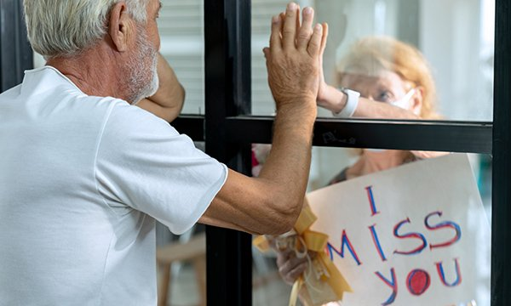
From frustration to anger in relatives

Slide 20
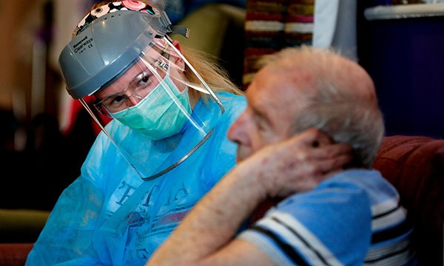
Carer burnout
“It’s increased stress levels and it’s increased our work. Whereas previously if I was working say Monday to Friday I could switch off. But now I’m pretty much working seven days a week.”

Slide 21
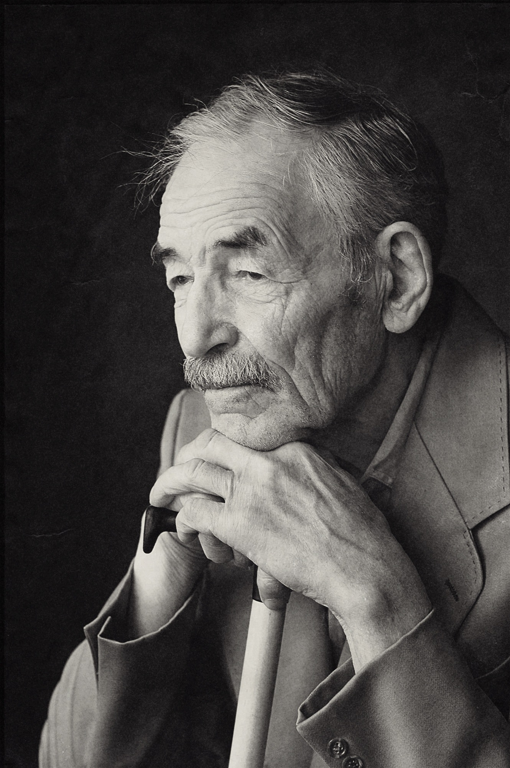
Systematic Review into effects of pandemic on people with dementia and unpaid carers
PROSPERO: CRD42021248050
Health and mental health, cognition
Social care access and use
Katarzyna Lion, Aida Suarez-Gonzalez, Rene Thyrian, Catherine Talbot, Klara Lorenz, Emily Wharton, Jacqueline Cannon, Hilary Tetlow

Slide 22
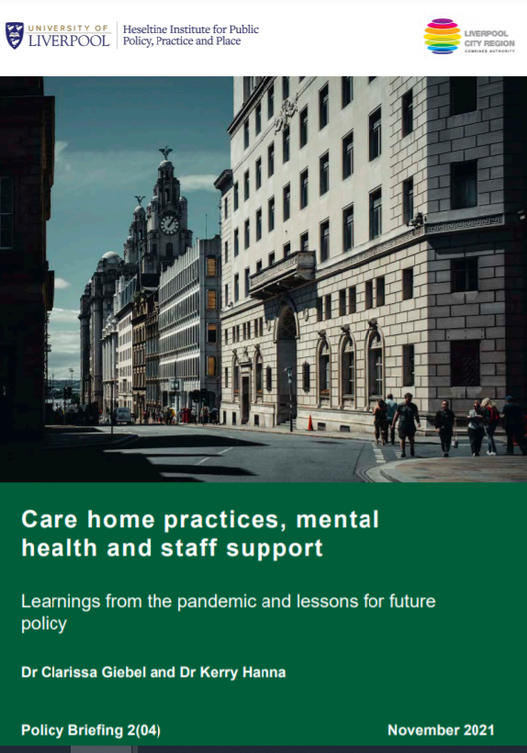
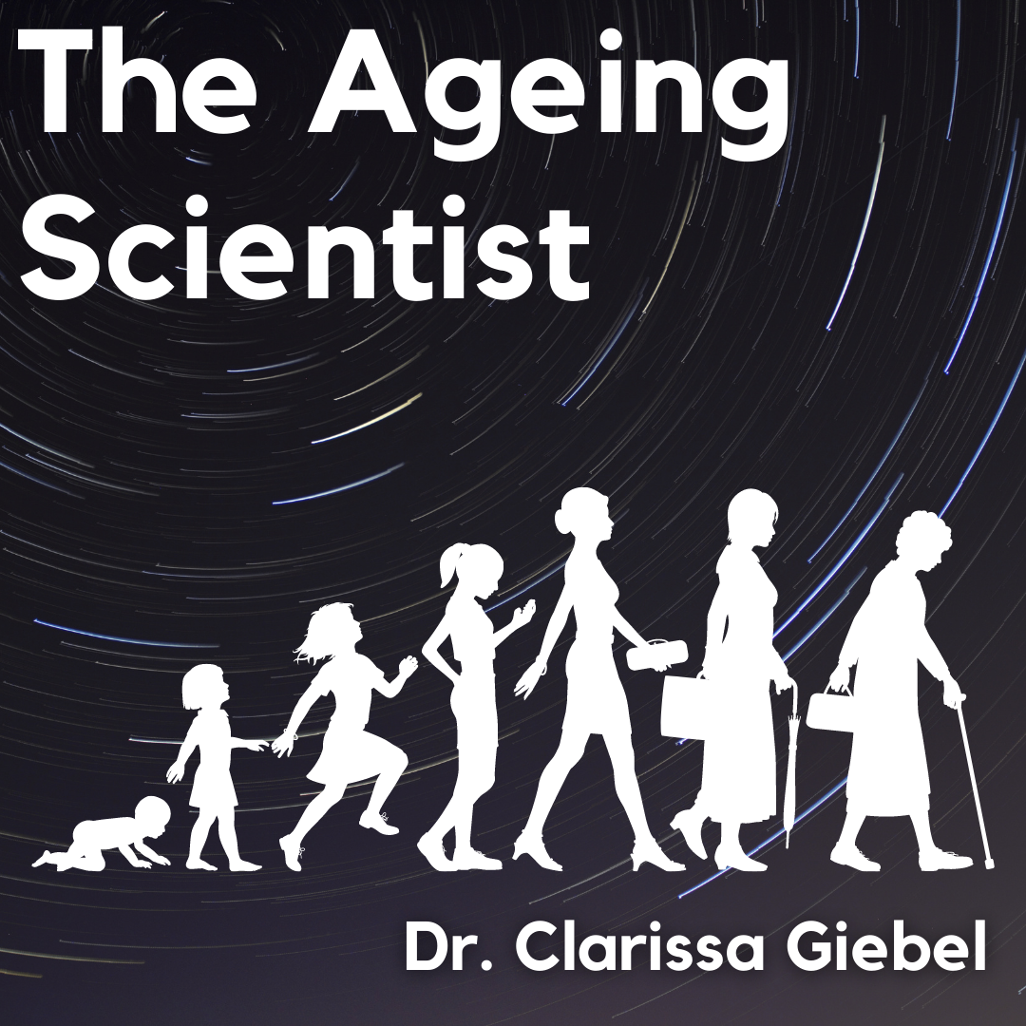
https://theageingscientist.podbean.com

Slide 23
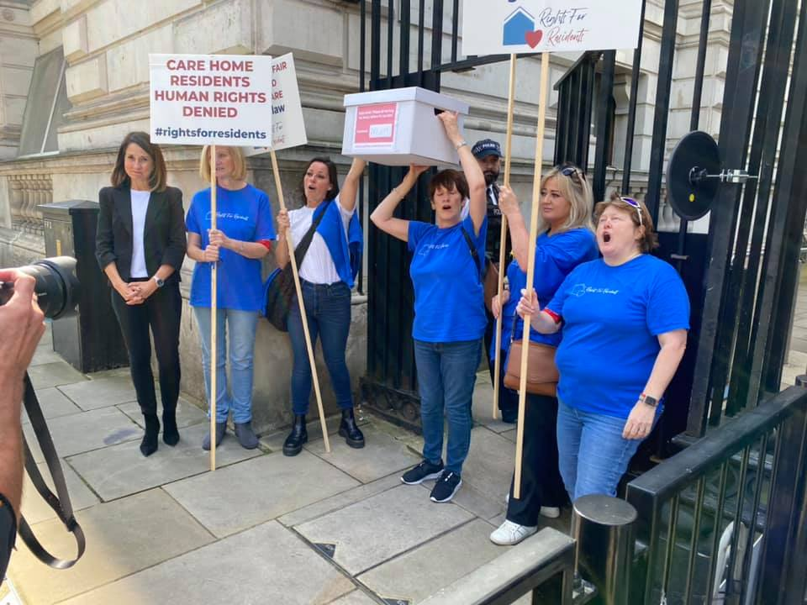


Unmet mental health needs of unpaid and paid carers for older adults with and without dementia
36 interviews (28 unpaid carers)
3 carers as public advisers
Rights for Residents

Slide 24

THANK YOU to all
Participants
Charities
People with lived experiences
Health and social care professionals
& Academic team members
Clarissa.Giebel@liverpool.ac.uk @ClarissaGiebel

