Slide 1
Applying for an MRC fellowship
Dr James Sheppard
Nuffield Department of
Primary Care Health Sciences
University of Oxford

Slide 2
What we’ll cover
Planning your application
Completing the application form
Preparing for interview
Peer review/feedback
‘Tips’ for the top

Slide 3

Make a plan
Starting thinking about it early – at least 18 months before the end of you current contract
Find more than one fellowship to apply for
  Research Council, NIHR, charities
Clinical/non-clinical

Slide 4
Making the most of your CV
Publications
  3 published papers (2 papers and 1 protocol)
  2 articles in press (including 1 letter)
Small grants/travel awards/prizes
  Small SPCR project grant (£35,000)
Presentations
Peer review
Teaching

Slide 5
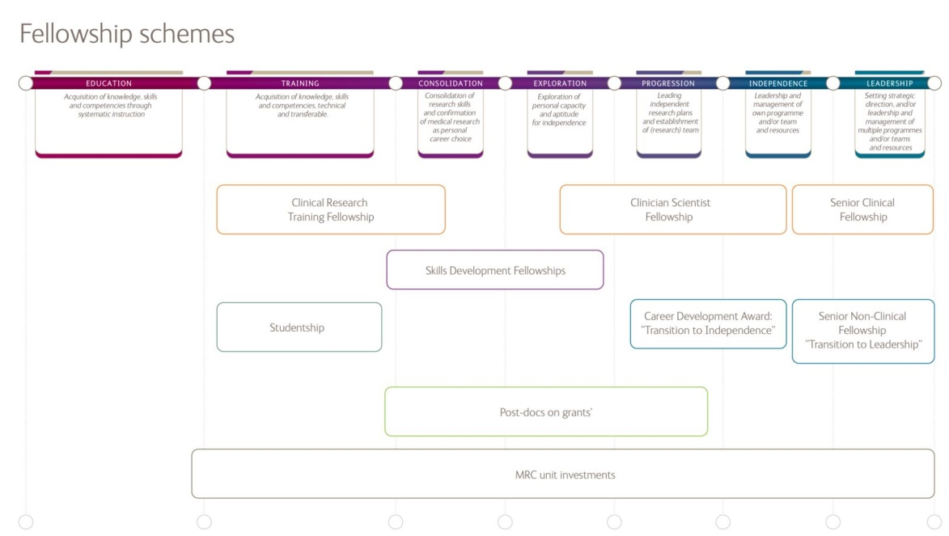
What fellowships do the MRC offer?

Slide 6
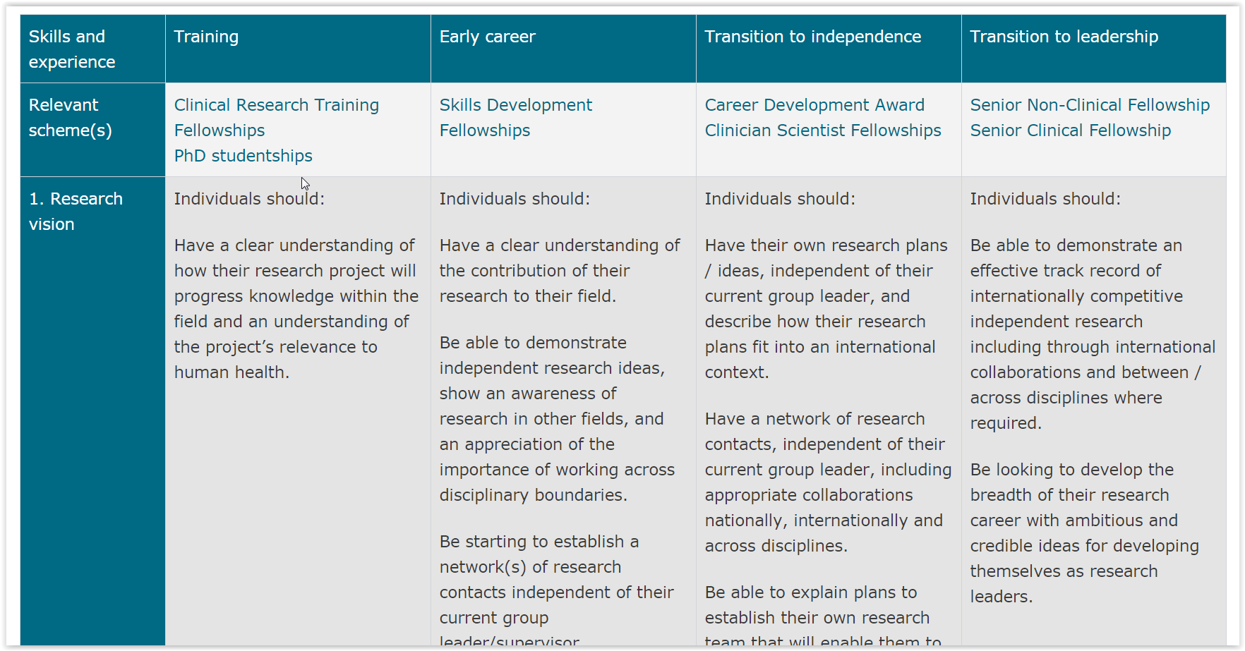
What fellowships do the MRC offer?

Slide 7
What are the MRC looking for?
  “The MRC’s fellowships are personal awards to talented researchers at key points in their careers. Fellowships provide funding for a challenging research project and an ambitious programme of research training and personal development.”
A project with scientific and clinical interest
Interesting and novel
Integrated training plan
Oversees travel

Slide 8
Planning a project and training plan
Don’t be too ambitious
Try not to plan workstrean 1 leading to workstream 2 leading to workstream 3
Avoid to much new data collection
  CPRD, systematic review (+/- IPD), re-analysis of trial data
Training courses at other centres
  MSc? PGCert?
Collaborate
  Other departments in the national school
  Oversees (data sharing?)
Consider moving to a different institution

Slide 9
Completing the application form
All applications must be submitted via the Joint Electronic Submission system (JeS system)
Read the guidance carefully
Online application + attachments
  Cover letter
  Application form (including costings)
  Case for Support (5-6 pages)
  CV (2 pages)
  List of Publications (1 page)
  Justification of Resources (2 pages)
  Pathways to impact
  Data management plan (3 pages, MRC template)
  Letter of support (Head of Department)
  Letter of support (Collaborators, mentors, etc)

Slide 10
Sorting out your costings
Ask for help
Look at other people’s applications
Read the guidance carefully
Post-doc grants don’t include research staff
Max reasonable ~£300,000
  ~£10,000 on 7 conferences + research trip
  ~£15,000 blood pressure monitors
  ~£20,000 consumables, publication costs, computer + software
  ~£8,000 training courses

Slide 11
What happens after you submit your app?
External peer review
Shortlisting
Panel interview
31 applications
16 applications (52%)
11 awards (35%)

Slide 12
Preparing for interview
Read up on the topic
Have a mock interview early
Prepare a response to every criticism of you application
Find out who’s on the panel
Think about your ‘10 year career plan’

Slide 13
Panel Scoring
  10. Exceptional – Top international programme
  9. Excellent – Internationally competitive and leading edge
  8. Very High Quality – Internationally competitive
  7. High Quality – Leading edge nationally, international quality in parts
  6. High Quality – Leading edge nationally, but not yet internationally competitive
  5. Good Quality – Nationally competitive
  4. Potentially Useful – with significant weaknesses
  3. Potentially Useful – With major weaknesses
  2. Poor Quality – Bordering on unacceptable
  1. Unacceptable quality or has serious ethical concerns
  0. Ineligible for funding

Slide 14
What happens next?
1 week until decision
1 month until confirmation of the final award
MRC induction day (September/October)
Fellows’ day (May)

Slide 15
‘Tips’ for the top!
Prepare well in advance
Take the initiative
Be persistent
Speak to other people (+ use the RDS)

Slide 16
Thank you for listening!
Email: james.sheppard@phc.ox.ac.uk
Twitter: @jamessheppard48

