Slide 1


Developing research priority areas to improve treatment pathways and outcomes for people with co-occurring mental health problems and alcohol use disorders
Dr Laura Goodwin, Mr Phil Parkes, Ms Rose Johnston, Dr JoAnne Puddephatt, Dr Patsy Irizar, Dr Kat Jackson & Dr Amy O'Donnell

Slide 2
Overview of the presentation
What do we know about the association between mental health and alcohol use?
An overview of current guidance for treatment and the different treatment pathways
An overview of the public workshops
Findings on the most common treatment pathways and the positives and negatives
Outcomes of the priority setting activity
Clinical implications and next steps

Slide 3
Common mental health problems and alcohol use (APMS)
Adjusted for gender, age, marital status, ethnicity, having children in the household, occupational grade, education and housing tenure
Puddephatt, J. A., Jones, A., Gage, S. H., Fear, N. T., Field, M., McManus, S., McBride, O., & Goodwin, L. (2021). Associations of alcohol use, mental health and socioeconomic status in England: Findings from a representative population survey. Drug and alcohol dependence, 219, 108463. https://doi.org/10.1016/j.drugalcdep.2020.108463
Notes:
This graph is showing the odds of both hazardous and harmful drinking comparing those with and without each mental health problem.
These odds were from multinomial regressions with low risk drinking as the baseline category.
You can see that the odds are stronger for harmful compared to hazardous drinking with significant odds from 3 to 4 for harmful drinking.
Associations for hazardous drinking were closer to 1 but there were statistically significant associations for generalised anxiety and PTSD.
Interestingly these associations remained after accounting for socioeconomic status (using multiple measures) as we thought that some of the association may be explained by harmful drinking being more common in lower SES groups.

Slide 4
Severe mental health problems and alcohol use (APMS)
Adjusted for gender, age, marital status, ethnicity, having children in the household, occupational grade, education and housing tenure
Notes:
All associations were statistically significant for both hazardous and harmful drinking for severe mental health problems, other than for probable psychosis.
The odds of harmful drinking are particularly high – around 7 for bipolar disorder and approaching 10 for antisocial and borderline personality disorder – showing strong associations.
This shows that associations do differ across type of mental health problem and again this is after accounting for any sociodemographic differences between those with and without a mental health problem.

Slide 5

What is the direction of the association?
1. Alcohol use increases the risk of MH problems due to biological effects (e.g. through changes in metabolism or neurotransmitter function) or through the negative social effects of having an AUD
2. Worsening MH results in an increase in alcohol use and risk of AUD through using alcohol to cope e.g. self-medication hypothesis
3. There may be common risk factors for both e.g. exposure to traumatic events or childhood adverse events or genetic/environmental risks
Studies looking at directionality have found stronger evidence for an association from
MH AUD
(e.g. Bell & Britton, 2014; Treur et al., 2021)
Notes:
There has been research looking at the direction of the association and there are 3 key theories:
That alcohol use leads to poorer mental health due to both the biological effects and social effects from heavy drinking, for example, someone may become more isolated from friends and family
The second explanation is that if someone experiences worsening mental health they may increase their alcohol use because they use alcohol to cope – this is known as the self-medication hypothesis
There is likely to be a bidirectional relationship and there are shared risk factors for both, for example, experiencing adverse childhood experiences or through environmental risks, e.g. living in poorer housing
There are some studies that have looked at the association, including one recent review by Jorien and a UK study that used cohort data – and they have both found more evidence for an association from MH to alcohol use rather than the other direction

Slide 6

Barriers to care
Alcohol use can delay someone seeking help for a mental heath problem, due to them coping by ‘self medicating’
Alcohol use can provide a barrier to someone starting mental health treatment, if they don’t meet the eligibility criteria
Told to reduce drinking before they can be seen by services
Hazardous and harmful drinkers are more likely to drop out of IAPT services (Buckman et al., 2018)
Even though they have equal treatment outcomes if they adhere to treatment
Someone with serious mental health problems may not be seen by addiction services – if substance use is thought to be a consequence of their mental health problem/their needs are ‘too complex’

Slide 7
What are the different treatment models?
The current NICE guidelines describe three treatment models for co-occurring problems:
Serial - one service at a time
Parallel - both services at the same time
Integrated - mental health and alcohol/drug needs are addressed at the same time as part of an integrated package of care. Does not have to be delivered in same location/by same person

Slide 8

PHE guidance: “Better care for people with co-occurring mental health and alcohol/drug use conditions”
Everyone’s job - Co-occurring conditions are the norm rather than the exception, and commissioners and providers of mental health and alcohol and drug use services have a joint responsibility to work collaboratively to meet the needs of people with co-occurring conditions.
No wrong door - Providers in alcohol and drug, mental health and other services have an open door policy for individuals with co-occurring conditions.

Slide 9
Objectives of the workshops
To identify the most common treatment pathways and models experienced by people with co-occurring mental health and alcohol use disorders, including whether the treatment model was i) serial, ii) parallel or iii) integrated.
To understand stakeholder views on the positives and negatives of each of these treatment pathways.
To develop a list of priority areas for research to improve the care of people with co-occurring mental health problems and alcohol use disorders.

Slide 10

Method for the workshops: Who attended?
Two online workshops were held with 25 public representatives with lived experience of co-occurring mental health and AUDs and professionals who work with them (e.g. health professionals).
Seven people attended workshop 1 with 18 attending the second. Snowball sampling was used to engage attendees.
All attendees were offered a £50 voucher as a thank you for their participation in the workshops.

Slide 11
Overview of the process
The first half of both workshops involved structured discussions on the positives/negatives of each treatment model.
In workshop 1, attendees were also asked to propose research questions which could improve the care of those with co-occurring problems.
Between workshops 1 and 2, these ideas were refined into 20 questions
The research questions were ranked in workshop 2 using a process based upon the James Lind Alliance process.

Slide 12
How did we undertake the priority setting activity?
The James Lind Alliance (JLA) guidance for priority setting (James Lind Alliance, 2021) was used as a guide to plan the sessions. Only 2 x 2.5-hour workshops were ran instead of the JLA suggestion of 12-18 months, due to researcher and fundings limits.
Notes were taken via Padlet (an online sticky note) by one of the facilitators and from the zoom chat. This was instead of doing a survey as it was a way to introduce everyone to the topic of the workshops and was less time-consuming.
Work was undertaken between the workshops by the research group to synthesise the original ideas into 20 research questions, with overlapping items combined.
The workshops included small group discussions which fed into group ranking sessions and finally a whole group review of the research priorities. Only one round of ranking and review occurred in these workshops and final feedback was sent after workshop 2 by email.

Slide 13

What were the outcomes of the public workshops?

Slide 14
Serial (Alcohol and then Mental Health treatment) - over 75% thought this was most common treatment pathway
Positives:
Easier to engage with mental health treatments after reducing alcohol use and allows you to focus on one problem at a time
•Therapists in alcohol services can give you tips on how to cope with your emotions
•People’s mental health can improve after treating the alcohol problem (though it depends on the complexity of the problem)
Negatives:
Wait times between different treatments, for example, after residential alcohol treatment
•If there is a delay in follow up mental health treatment, people go back to alcohol to self-medicate .
People become acutely unwell quickly, and alcohol services cannot offer the specific mental health support needed.
Lack appropriate coping skills to cope with mental health issues and if people are returning to the same circumstances they can consequently return to using alcohol

Slide 15
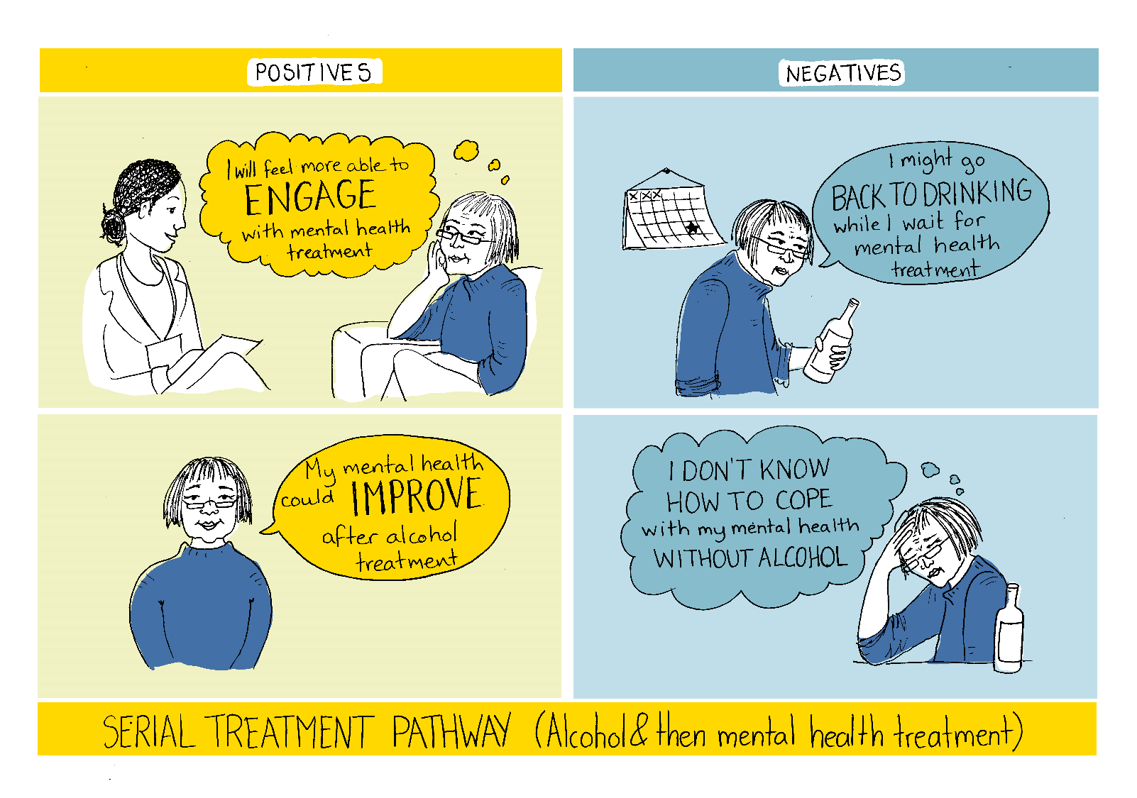

Slide 16
Serial (Mental Health and then Alcohol treatment)
Positives:
Helpful if the individual is able to control their drinking
Easier to address the alcohol issues if their mental health is stable
Can tackle the underlying cause of alcohol/substance use, i.e. if alcohol is being used to cope with the mental health problem
Negatives:
Eligibility for mental health services can be affected if using alcohol to self-medicate
Yet, support isn’t always provided to reduce one’s drinking
Have to be in crisis with your mental health to be seen
If someone is still self-medicating, this may prevent the mental health treatment from being effective

Slide 17
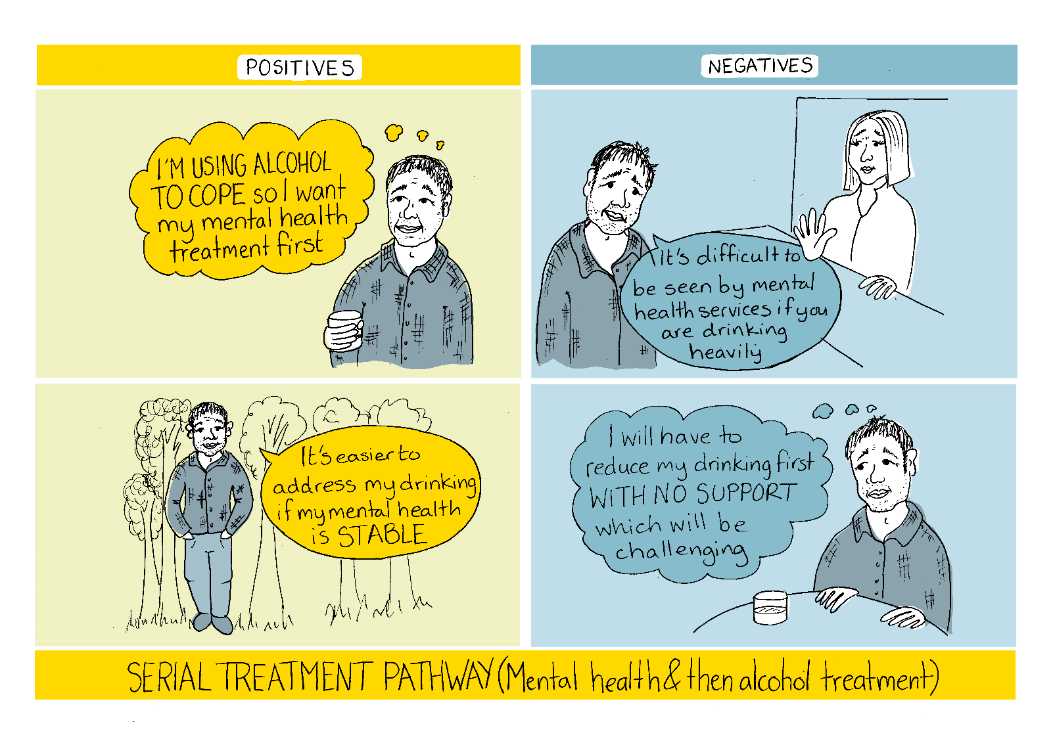

Slide 18
Parallel (Different services, but Alcohol and Mental Health treatment at the same time)
Positives:
You are not reliant on one service having all the answers and provisions
You can benefit from the specialist areas of both services
Having separate appointments for each problem can take the pressure off from having to address everything at once
Provides a more holistic approach as both services might offer slightly different things
Negatives:
Lack of communication between services and problems with sharing personal information
•Separate services may miss the interconnectedness of both problems and it's important to think about the individual and their specific issues
•There is not enough mental health knowledge in the alcohol services
Does not always take a trauma informed approach as service users may need to keep repeating their story

Slide 19
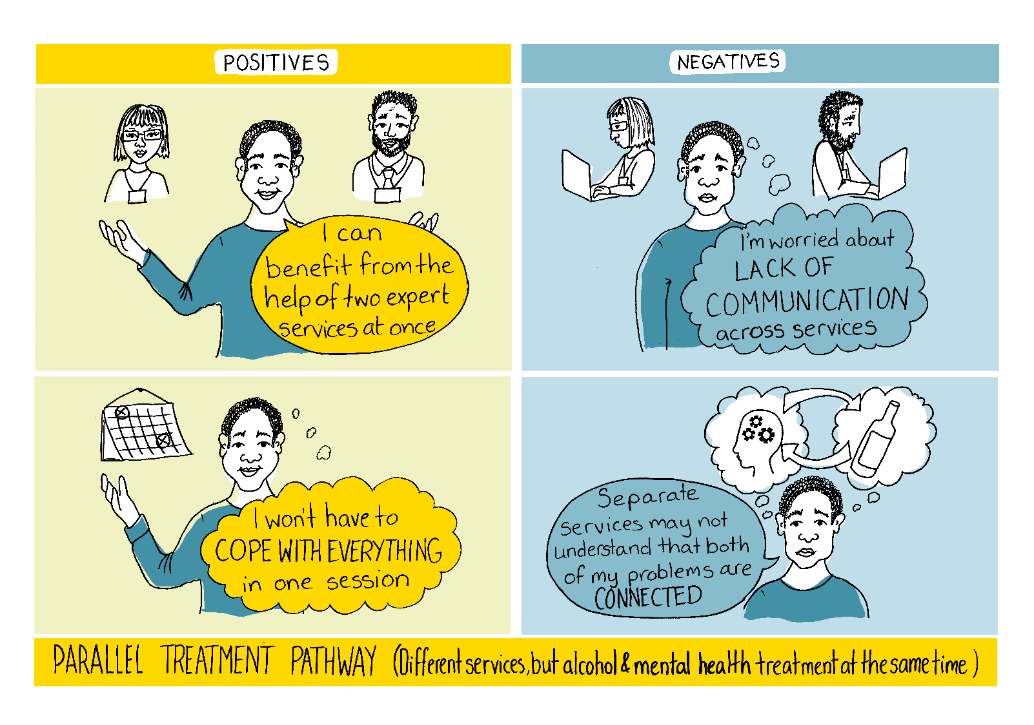

Slide 20
Integrated (The same service at the same time)
Negatives:
• To be effective, services need to ensure there is a good after care plan in place
Concerns around information sharing – if this treatment pathway is provided by the GP or NHS, people may be reluctant to come forward in case of wider implications, such as on employment or children.
May require service providers to have the expertise and specialist skills to provide support for both problems
It can be too overwhelming to deal with both problems at once
Positives:
Help for everything in once place
Fewer communication issues and has the potential to lead to better outcomes for service users
Services/therapists know all about your mental health and alcohol issues and you do not have to re-tell it all
Better integration with other organisations, e.g. recovery services, can help address an individual's wider needs

Slide 21
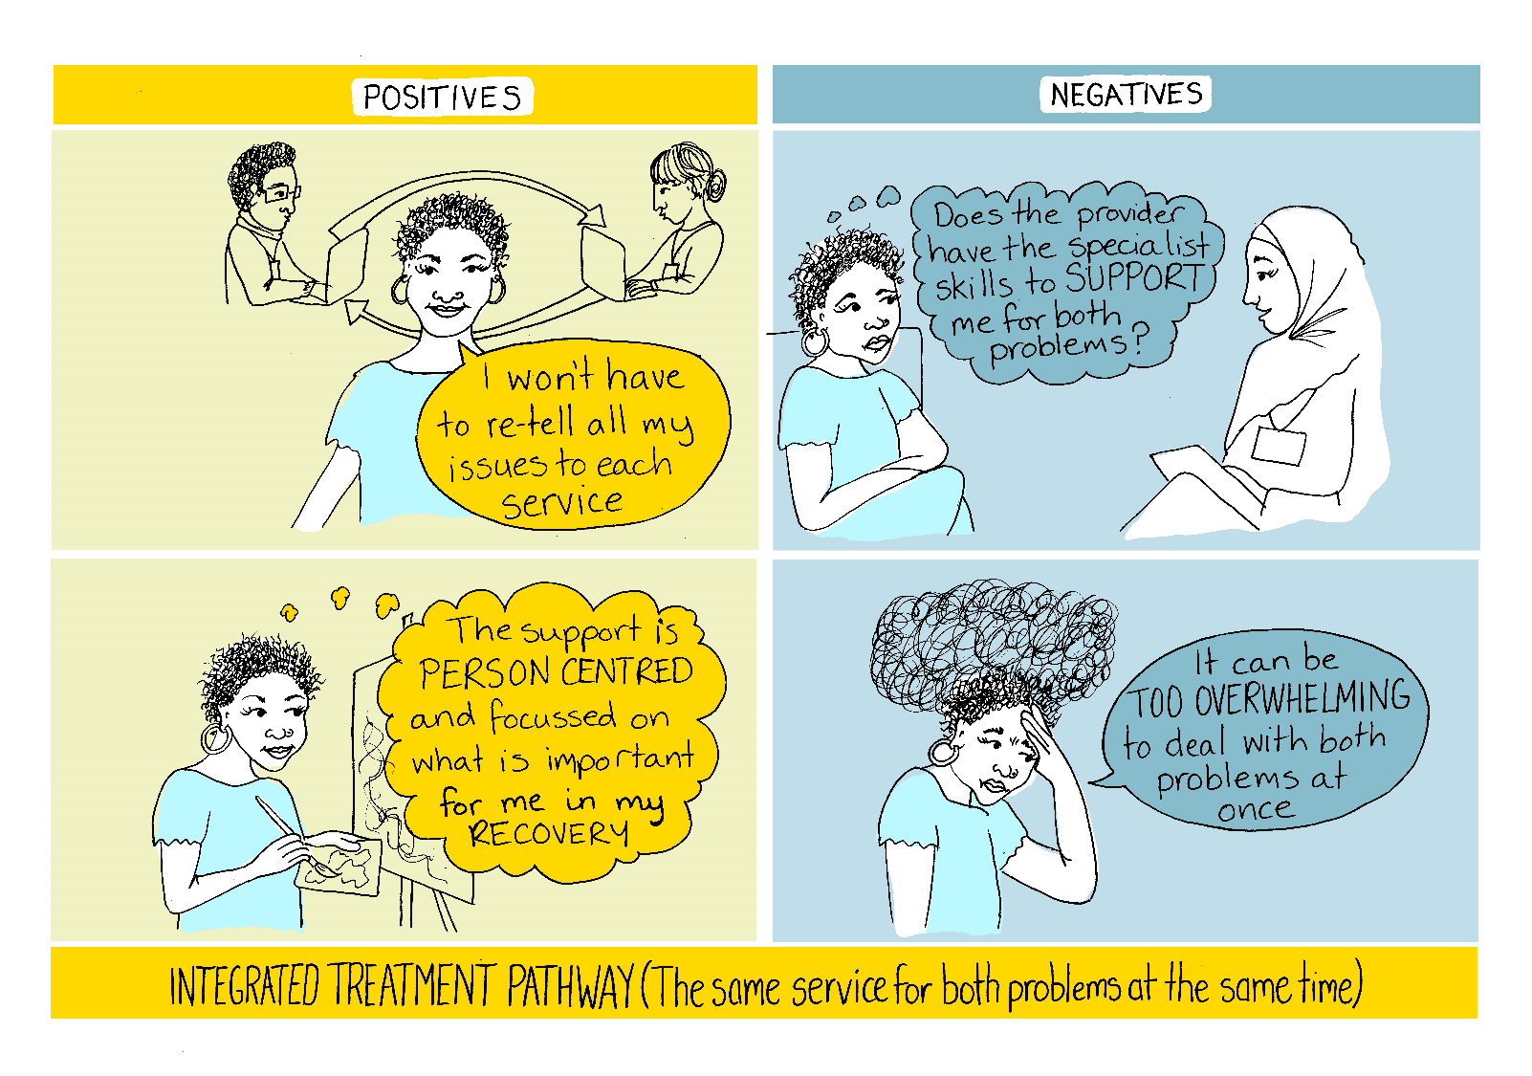

Slide 22
The top 10 research questions from the priority setting activity
1. Where are people with co-occurring problems most likely to present and does that depend on which condition developed first?
2. What are the needs of carers and family members of people with co-occurring problems and how can they be better supported?
3. What does integrated care look like for people with co-occurring problems?
4. Why is peer support and guidance from people with lived experience helpful to people with co-occurring problems?
5. What are the barriers to services (e.g. mental health and alcohol services) being integrated or working more closely to support people with co-occurring problems?

Slide 23
The top 10 research questions from the priority setting activity
6. What are service user experiences of the different treatment pathways, for example, serial vs parallel treatment?
7. How can we involve people with co-occurring problems who aren’t accessing services in research?
8. Is social prescribing (i.e. referring people to community groups and activities) helpful to people who have co-occurring mental health and alcohol problems?
9. What are the skills and training needs of people working in mental health and alcohol services to support people with co-occurring problems?
10. How can we involve groups who may be less likely to access treatment in research, e.g. people from ethnic minority groups?

Slide 24
Conclusions
Public involvement in this research provided valuable insight into different treatment pathways.
Findings suggested that serial treatment (alcohol followed by mental health) was the most common, but this may not always be the most appropriate.
Future research priorities for this field were identified, highlighting the importance of family members and carers and understanding where people first present for treatment.
This process showed that it is possible to undertake priority setting activities within a short timeframe.

Slide 25
Next steps and implications
We are working with Phil to disseminate the images summarising the treatment pathways around third sector and community organisations.
Joint presentation submitted to the UK Society for Behavioural Medicine conference in Birmingham.
We have been funded by the NIHR to undertake a Programme Development Grant on ‘Improving treatment pathways for people with co-occurring MH and AUDs’
Phil is PPI lead on this project
The findings from these workshop will strongly feed into this work.
Our long-term plans are to inform the development of updated public health/clinical recommendations and to develop guidance for service users and their families.
It is important that any new recommendations consider the type of treatment pathways that are typically delivered.

Slide 26


Thank you to the NIHR Three Schools' Mental Health Research Programme for funding these workshops and to the following organisations who have supported this work:
Expert Citizens
Change Grow Live
Mersey Care NHS Foundation Trust
Empowerment Charity
Champs Public Health Collaborative
Please contact us if you want to know more about this work or have any suggestions:
Email: l.goodwin1@lancaster.ac.uk or volunteer@expertcitizens.org.uk

