Slide 1
Publishing with
The Lancet Primary Care
Notes:
Our website is a really good source of information. Much of the content on my slides can be found online, so please do check us out if you’re considering publishing with us!

Slide 2
Agenda
Journal information (processing, team, aims and scope)
Essentials for preparing your manuscript
Writing tips
Editorial processes (Editor roles, peer review)
Post-acceptance

Slide 3
About the journal

Slide 4
The Lancet Primary Care
www.thelancet.com/lanprc/about
A gold open access journal, providing a solution for authors of original research with funding that requires OA publication while they retain their copyright.
We publish content Online First, subsequently incorporated into monthly online issues.
Fast-track publication allows for quick and efficient publication of papers of immediate public health or clinical importance.
Notes:
The journal is gold open access (or fully open access). We publish a range of content types including Articles, Reviews, Viewpoints, Comments, and Correspondences. All content, including Reviews and Comments, is published under a Creative Commons license, with an article processing charge (or APC) that applies to full-length papers that are peer reviewed. For authors who do not have institutional or funding body support for APCs, we offer discounts and waivers as standard, which you can explore in more detail if you go to our journal’s About page.
We publish content Online First, which is then incorporated in monthly online issues. We also include so-called “extras” with each issue, such as podcast episodes and the journal’s Editorial piece.
It’s worth noting that fast-track publication is available on papers of immediate public health or clinical importance. These papers are subjected to the same standards of peer review.

Slide 5



Our Editorial Team
www.thelancet.com/lanprc/about
Yaiza del Pozo Martín
Jessica Smith
Lauren Southwell
The Lancet Primary Care, Editor-in-Chief
delpozomartiny@lancet.com
The Lancet Primary Care, Senior Editor
jessica.smith@lancet.com
The Lancet Primary Care, Senior Editor
lauren.southwell@lancet.com
Notes:
This is our editorial team. We all come from clinical or research backgrounds and, combined, have decades of editorial experience.

Slide 6
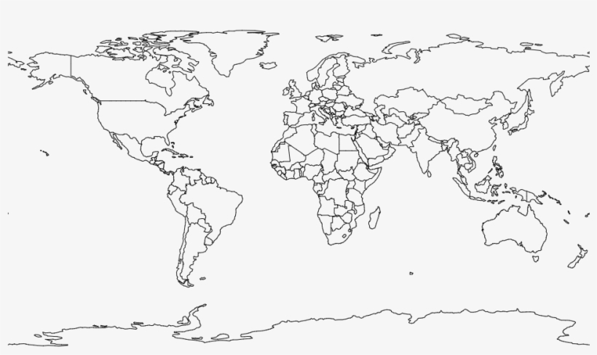
Our International Advisory Board
Representative of the community
Aiming for inclusivity
CHWs, nurses, and midwives
GPs at the intersection of primary care and other specialties
Pharmacists and ophthalmologists, encompassing broad aspects of primary care
Notes:
The IAB don’t have any formal involvement in content selection or selection of peer reviewers and don’t have editorial oversight of any section of the journal. You can see the full list of members on our website, via the About page also.

Slide 7




Reasons to publish with us
www.thelancet.com/why-publish
Expert guidance
No matter which Lancet journal you choose to submit to, there are several pathways to publication, which are supported by our collaborative, expert editorial teams.
Global reach, high impact
Papers are amplified to a truly international audience, reaching millions of readers, and triggering actions to protect and promote health.
Personal support and service
You get the support you need from our international team of editors and publishing professionals throughout peer review and the full journey of your paper.
Improving lives
Our authors are a global community concerned with advancing the health and wellbeing of people worldwide.

Slide 8


Aims and scope
www.thelancet.com/primary-care
WHO’s primary health care vision
Primary care and public health integration
Community care and empowerment
Engagement with political and allied society organisations

Slide 9
Aims and scope
Clinical decision making
Beyond family medicine and general practice
Research into nurse-led and CHW-led interventions
Community health interventions (eg, schools, rural areas, etc)
Collaboration between different professionals (eg, nurses, midwives, CHWs, nutritionists, psychologists) in primary care
Notes:
Can this research aid health professionals to deliver evidence-based care or potentially even change practice​? How does it work and what are its mechanisms?
When we talk about health professionals, we don’t mean GPs only. We are interested in the experiences of and interventions led by community health workers, nurses, schools, really any areas where primary care can be delivered. Primary care is inherently a broad field, and we look for novel and interesting research in all relevant facets.

Slide 10
Aims and scope
Care delivery
Person-centred care to address complex health needs
(eg, multimorbidity or chronic disease)
Patient-provider experience
Continuity of care, values-based care, collaborations, and referrals
Digital health integration (eg, eConsults, AI)
Equity (eg, key at-risk populations)
Notes:
How care is delivered? We publish research exploring all manner of aspects of primary care delivery, such as relational care, continuity of care, person-centred care, all the way to the role of technology in care delivery​.
At the core of this category is equity. Is the method of care currently equitable? If not, why not? How can we change this?

Slide 11
Aims and scope
Health services research
Collaboration between primary and secondary or tertiary services
Workforce and workload issues
Primary care reform and financing
Quality indicators
Future health systems, resilience, and adaptability
Notes:
How is care structured and financed? What is the composition of the workforce? Are these models of care effective?
This is an area that can be absolutely crucial and yet overlooked. This kind of work can really make a difference, especially for systems in LMICs that are substantially underfunded or under-resourced. Innovative solutions with comprehensive analyses has the potential to capture the attention of governments and policymakers.

Slide 12


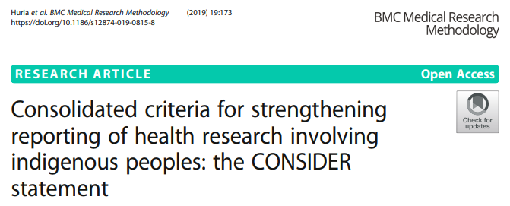
Advancing equity, diversity, and inclusion
www.thelancet.com/equity-diversity-inclusion
Advocating equity and valuing diversity and inclusion is part of our mission.
We commit to tracking and reporting publicly how the Journal is doing in terms of reflecting the global community we serve (ie, in terms of the gender, ethnicity, geographical base, etc) of our authors, reviewers, and advisors.
Notes:
We use a variety of checklists, such as the SAGER guidelines for sex and gender reporting, the CONSIDER statement for reporting of health research involving Indigenous peoples, and the CRISP guidelines to improve the reporting of research relevant to primary care. These are all available in our information for authors, and we ask that you use them to ensure accuracy and validity.

Slide 13
Content priorities
www.thelancet.com/what-we-publish
High priority:
Interventional RCTs
Observational studies (prospective and retrospective)
Implementation and mixed-methods research
Meta-analyses
Post-hoc studies
Qualitative research
Methodological studies
Trial protocols
Open to:
Out of scope:
Notes:
In terms of Articles, we have a good demonstration here of not only what we do and don’t consider, but also what we tend to prioritise as a busy open access journal.

Slide 14
Essentials for preparing
your manuscript

Slide 15
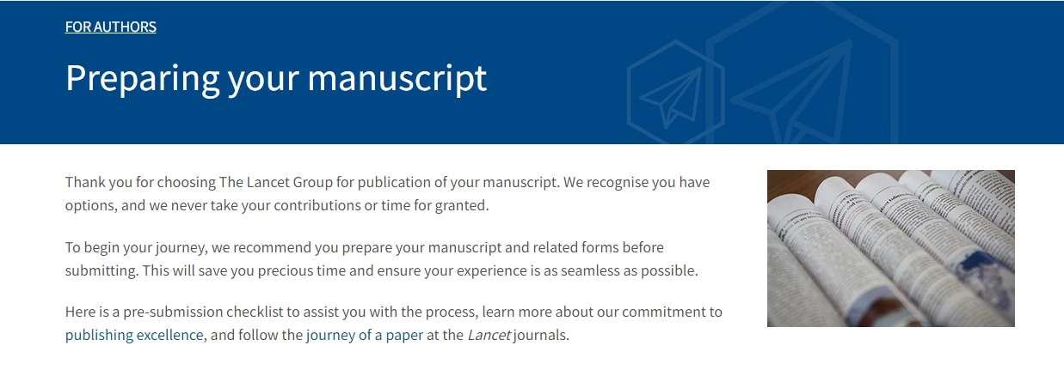
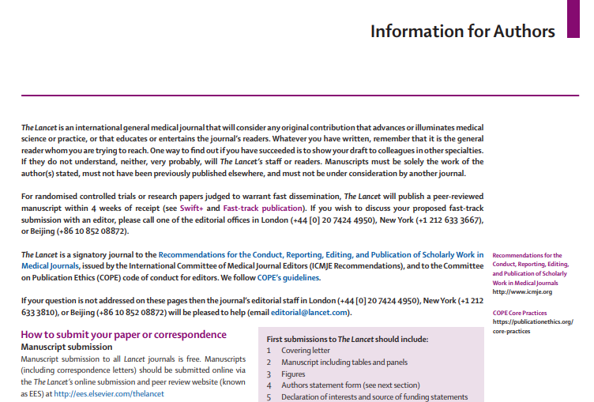
Preparing your manuscript
www.thelancet.com/preparing-your-manuscript
Notes:
The first suggestion is that you read the journal’s information for authors, which provides guidance on how to format the paper and what forms are required for submission. Although much of this will be consistent from journal to journal, it’s really worth reading the fine print and this is likely to save time in the long run. For Lancet journals, you can find our general guidance on the journals about page and using the link shown; we also provide a handy pre-submission checklist.

Slide 16

What we look for: positives
Relevance to the journal’s scope and readership
Novelty
  - Importance of the question you’re addressing
  - Treatment or prevention technique
  - Population
  - Knowledge of disease distribution
  - Strong support for conclusions
Other considerations
  - Policy relevance
  - Societal and clinical relevance
Robust methodology
Study design (controls, validation, assumptions)
Sample size (statistical power)
Use of appropriate guidelines (eg, CONSORT)
Transparent data and reporting
Notes:
In addition to the preferences shown here, we require: a protocol (if applicable), data verification, a cover letter, and appendices, if relevant.
We also check for things like: prospective registration, per-protocol reporting, a statistical analysis plan, and complete and accurate forms and author statements.
Having all of these things in order when submitting can save a lot of time in us reaching a decision, but can also help you triple check your work and fully consider it, making sure you’ve covered every base.

Slide 17
What we look for: negatives
Poor question selection/inappropriate patient group or endpoint
Lack of comparator group
Underpowered―too few participants to be conclusive
Over-reliance on ad-hoc or exploratory analyses
For trials, lack of protocol, unplanned post-hoc analysis (not signposted), or lack of trial registration
For predictive tools or risk stratification studies, lack of validation in an independent cohort
Plagiarism
Salami slicing
Notes:
In addition to the positive attributes that editors look for, there are also things that we don’t want to see.

Slide 18

Submission – writing tip #1
Use the cover letter wisely
Describe the clinical relevance of the findings
Don’t oversell findings
Why this journal?
Please also mention if you discussed the work with us before
If this work has been or will be presented at a conference
If you would like to align publication with a specific event or conference, etc
Notes:
The first writing tip is to absolutely make the most of your cover letter. We read every one of these and use them as signposts as to why we should consider this work, what it adds to the field, why the authors believe it should be published by us specifically, and many other crucial points that can help get your paper noticed. However, we want to see balanced interpretations; sell your paper, but don’t oversell it.
The cover letter is also a very good place to indicate any hard deadlines or collaboration between organisations that apply to the paper, so that we are aware moving forward and inform our post-accept teams as necessary.

Slide 19

Submission – writing tip #2
Title: non-declamatory, accessible, informative, with study descriptor
Tell a story, contextualise for non-specialists
Lancet Healthy Longevity 2025; 6: 100706
Notes:
The title should be non-declamatory, accessible, and informative. Essentially, we want a clear neutral title that describes the research but does not attempt to skew the reader one way or the other.

Slide 20
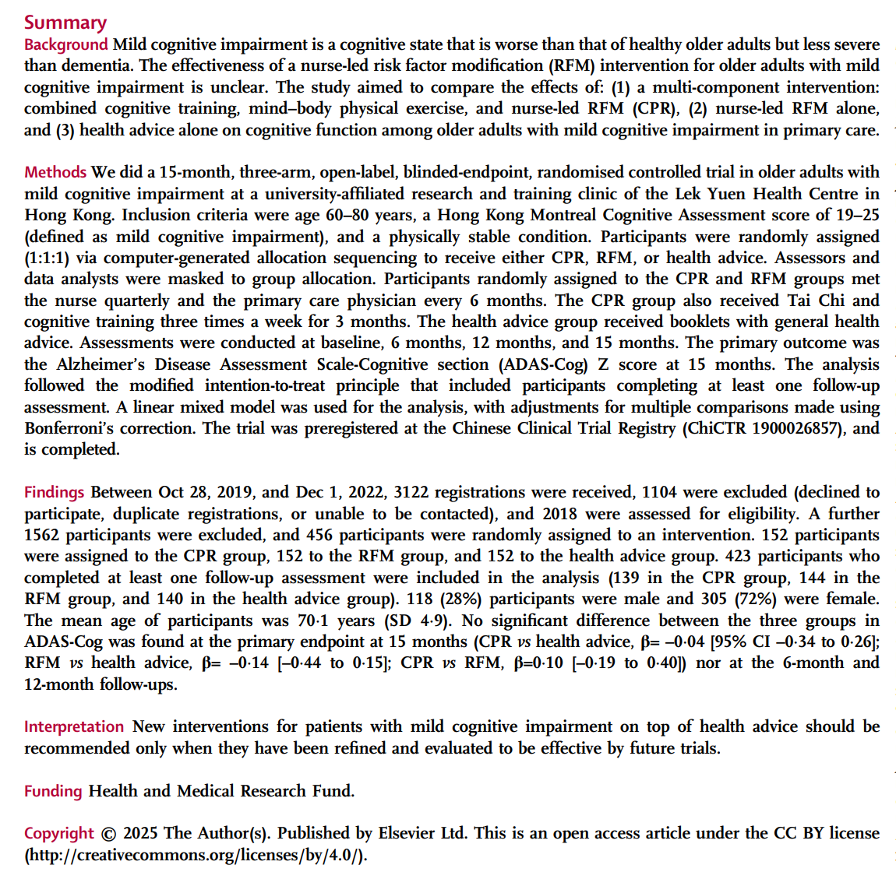
Submission – writing tip #3
www.thelancet.com/submission-guidelines
Abstract: Provide key methodological details and results, following appropriate reporting guidelines
Study aims and background
Methods: Study setting and population criteria, key procedures, primary outcome and analyses, study registration details
Findings: study dates and population details, primary outcome results, safety results
Interpretation: appropriate in light of study findings, implications for clinical practice or policy
Lancet Healthy Longevity 2025; 6: 100706
Notes:
In the Abstract, we want all the key information. The requirements for what is included in the Summary vary between paper types, so again please do check out the website and make sure to check the formatting guidelines for your specific paper type. This not only helps us pre-accept, but helps the copyeditor work with your paper post-accept.

Slide 21

Submission – writing tip #4
Methods, methods, methods
Be clear and provide enough detail
What type of study is it?
What study population are you investigating?
Ethical approval and patient consent
Intervention procedures or methods of observation
Outcome measures and methods of assessment
Statistical analysis
Any protocol deviations
Role of the funding source
Notes:
For the Methods in the main text of the paper, the overall goal is to ensure that you include enough detail so that anyone can repeat what you’ve done.

Slide 22

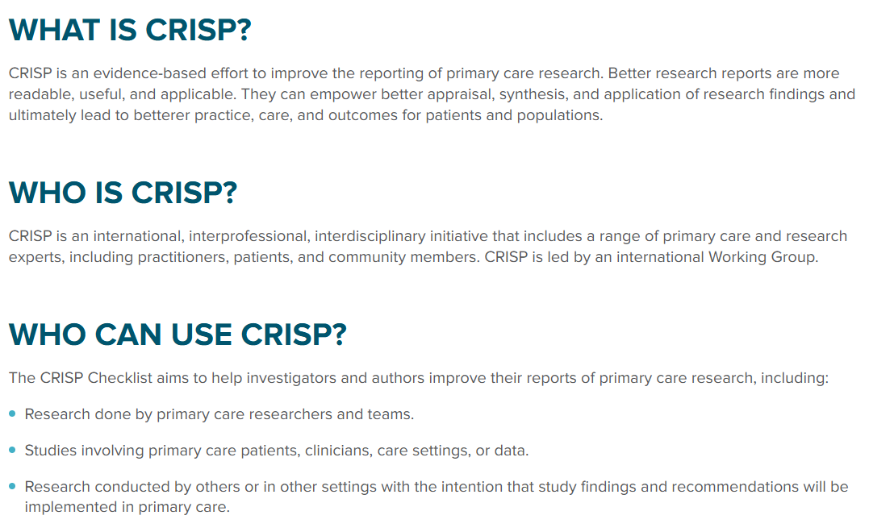

Submission – writing tip #5
Reporting: honest and transparent, follow guidelines
Report as specified by protocol
Include protocol, SAP, trial registration
Complete reporting of all outcomes – don’t cherry pick/gloss over
Adherence to guidelines
www.equator-network.org
Notes:
We want to see that you have followed the relevant guidelines as closely as possible. This is not only for ease of assessment, but for the accuracy and validity of your research.

Slide 23
Submission – writing tip #6
Discussion: limitations and implications
  Briefly recap the key findings
  Don’t over-interpret or ‘spin’ the results
  Be critical and open about limitations
  Contextualise the findings. What are the implications?
  What are the next steps for the field?
Notes:
And finally, we want you to discuss your paper! What did you find in regards to your primary outcome? Is this what you expected? What could have been done better or what did you omit? How does this generalise beyond the area/country/region in which the study was conducted.

Slide 24
Editorial processes

Slide 25
Editors’ core tasks
Selection of manuscripts for review process
Reviewer selection and overseeing the review process
Final decision on manuscripts
Various article quality and journal policy checks
Support achieving the impact published papers deserve
Extras!
Notes:
In addition to these aspects of our role, we complete additional content like podcasts and social media posts.

Slide 26
Editorial assessment and peer review
Editorial assessment:
Conceptual novelty and importance of a result in its own field
General interest, wider importance (eg, policy making)
Also:
Strong logical support for conclusions
Work that will inspire further research
Notes:
During each stage through which a manuscript progresses, we conduct quality checks and ensure alignment with our policies in close collaboration with our journal team and other in-house teams (eg, editors, illustrators, operations and product managers, etc), all of whom are dedicated to supporting your efforts to advance health worldwide.

Slide 27

Editorial assessment and peer review
Peer review at The Lancet
Single blind (anonymous referees)
3 clinical reviewers + 1 statistical reviewer
Specialist: modelling, health economists, qualitative research methods...
Diversity: gender, geography, seniority…
Local knowledge, especially when databases are used
Lived experience (eg, community health workers or patients)
Notes:
We oversee the peer review process for every manuscript. Peer review at The Lancet Group is single blind; the identity of the reviewer will not be revealed to the authors.​

Slide 28

Post-acceptance

Slide 29

Post-acceptance
Accepted Articles are:
Checked for technical elements
Sub-edited for grammar and clarity of scientific meaning
Formatted to our house style using specialised publishing software to create a version of the intended print page
Reviewed by illustrators to ensure illustrations, tables, and graphs adhere to journal style and convey appropriate meaning and interpretation
Notes:
After acceptance, high-quality scientific and technical editing is provided by our teams as they begin work on the manuscript and the internal review continues. The accepted manuscript will be edited, ensuring not only clarity and readability, but also completeness of reporting, consistency of data presentation, and fair interpretation of the findings. Our editorial teams work closely with our authors and our technical editorial and production teams to format the manuscript into the best possible paper, striving to be accurate and clear for an international audience.

Slide 30

Post-publication: global reach, high impact
Lancet journals are both a destination for publication and a platform to advance the global impact of research. The Lancet Group cares that your work is highly visible to a global network of researchers, clinicians, industry professionals, policy makers, media outlets, patients, and the wider public, and we can work with you and your affiliated institutions to maximise the impact of your research on the world.
Notes:
When the final content is ready, the paper is scheduled to publish, with both the designed PDF and an online version, on TheLancet.com and ScienceDirect. For authors presenting their original research at conferences, we will work with you to try and coordinate simultaneous publication under embargo.

Slide 31




Thank you!
primarycare@lancet.com
https://www.linkedin.com/company/lanprc
@lancetprimarycare.bsky.social
https://www.thelancet.com/primary-care

